Slide 1
Bellwork Jan 12, 2015
Using the third and fourth paragraphs in Lecture 20, answer the question below in at least five sentences (a full paragraph):
Why do some people call the early middle ages “the dark ages”? Why can the early middle ages also be considered far from dark?

Slide 2
Quiz Jan 12, 2015
Who was “the last of the Roman philosophers, and the first of the scholastic theologians,” whose section in lecture 20 started on the second page?
Who was the greatest king of the Frankish kingdom?
Which pope declared the First Crusade at a council in 1095?
In what year was the Children’s Crusade?

Slide 3
Grading the Quiz
Boethius
Charlemagne
Urban II
1212

Slide 4
Muhammad died in 632
Had not named a successor
Some selected Abu Bakr (wealthy merchant, Muhummad’s father-in-law) as caliph
Later, Muhammad’s son-in-law became caliph
When he died, a general became caliph and made the position hereditary for his family, creating the Umayyad dynasty
Moved the capital from Medina to Damascus
The Shi’ites would only accept descendents of Muhammad’s son-in-law
Sunnis accepted Umayyads as true rulers
= This division exists today

Slide 5
Made it a tradition to make raids on their enemies
Called it the jihad (striving in the way of the Lord)
Not meant to convert people
636 – defeated the Byzantine army
640 – Syria fell
650 – the entire Persian empire was under Muslim control
720s – Egypt, North Africa, and Spain were all under Muslim rule
732 – Muslim expansion in Europe was stopped at the Battle of Tours, in France

Slide 7
8th/9th Centuries = golden age of Islam
Gathered Arabic, Byzantine, Persian, and Indian writings in their raids
Translated them
Commented on them
Preserved them
12th century (High Middle Ages) Westerners were re-exposed to this old literature
Because the violent Early Middle Ages were over

Slide 8
The Crusades
Boethius
475-524
Descended from a prominent Roman senatorial family
Served under Theodoric, king of the Goths
Got on the wrong political side during a controversy
In jail, awaiting execution, wrote The Consolation of Philosophy
Combination of faith and philosophy
Dante, Boccaccio, Chaucer, Elizabeth I respected him

Slide 11
Bellwork Jan 13, 2015
Using Lecture 25, answer the question below in at least five sentences (a full paragraph):
Why did the Crusades begin in the 1000s?

Slide 12
The Venerable Bede
673-735
English Benedictine monk
Ecclesiastical History of the English People
Historians get almost all their information about England from this book
Covers 55BC to AD731
Bede started the use of anno domini
Believed history was orchestrated by God to save people

Slide 14
Charlemagne
Franks from the Germanic region spread into Gaul
Combining Germanic customs with Roman law
After Clovis, considered themselves the head of the Roman Catholic Church
Unstable until Charlemagne
742-814 (r. 771-814)
Combined Roman past, Germanic way of life, Christianity
Made a good foundation for Europe to finally grow strong
Wanted to unite all Germanic people under one throne
And convert them all to Christianity
By 800, controlled almost all of Europe
Christmas Day, 800, Pope Leo III called Charlemagne to Rome
Crowned him Emperor of the Romans
Created a new Roman Empire – the Holy Roman Empire
In which the pope is over the emperor

Slide 15
Charlemagne
Maintained loyalty by giving gifts of land and visiting
Persuaded an Anglo-Saxon monk to come to Germany to design a good curriculum
Created a classical education for clergy and monks
Started using upper/lower case, spaces, punctuation
Standardized medieval Latin
= set the stage for proper kingship and Christian expansion
827-1000s renewed invasions by Muslims, Vikings
Turned to feudalism for security and mutual obligation

Slide 17
Bellwork Jan 16, 2015
Using Pope Urban II’s speech and St. Benedict of Clairvaux’s letter to the Templars from yesterday’s Socratic Discussion, answer the question below in at least five sentences (a full paragraph):
How did Christian motives for the violence of the Crusades compare to Islamic motives for the violence of their Jihads?

Slide 18
Crusades
Started in 11th C (1000s)
Armed expeditions, led by popes
An outgrowth of religious revival
Brought West into contact with old forgotten ideas
Western Europe tired of the Holy Lands (Israel) being controlled by Muslims
That was where Jesus was born, preached, died
Christians wanted to go on pilgrimages there
1000s Seljuk and Ottoman Turks (Muslims) were making their way toward Constantinople
The Catholic and Orthodox Churches who had parted in 1054 now wanted to reconcile to be stronger together against oncoming Muslims

Slide 19
Pope Urban II
1042-1099
1095 messengers from the Byzantine Empire came to ask for help against the Muslim Turks
Urban made a speech calling Christian knights all over Europe to gather and march against the Muslims
Calls especially on the Franks in Germany because Charlemagne had so recently made them powerful
Pointed out that violence against Muslims would better save their souls than fighting each other at home

Slide 20
The First Crusade (1095-1099)
Peter the Hermit led a violent mob that did nothing but raid churches and kill other Christians
Better-equipped and disciplined armies led by lords
Expected gifts of land as reward
Byzantine emperor promised only if the lords promised allegiance to him
Took back Nicea, Antioch, and Jerusalem
Each spot became a crusader state, ruled under the Byzantine Empire by Western European lords

Slide 21
Templars
Order of knights founded in 1119 to protect pilgrims
Took vows of poverty, chastity, and obedience
Headquarters near Solomon’s Temple
Wore red crosses on white
Other orders
Cistercians
Hospitallers
Teutonic Knights
Caught up in getting wealthy
Got gifts of land and churches for their work

Slide 22
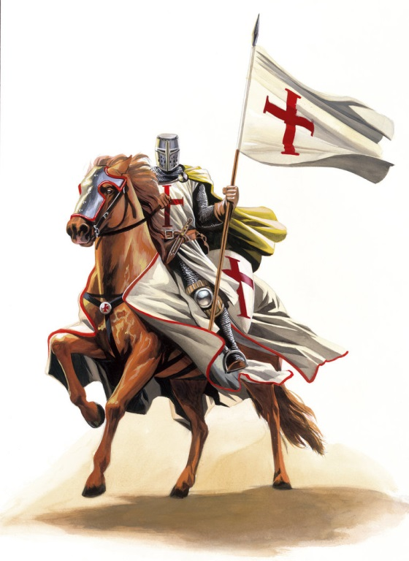
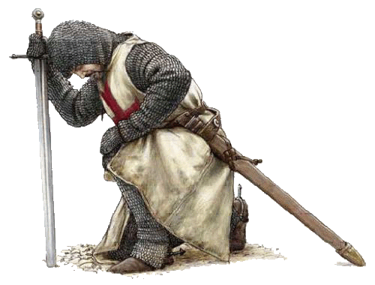
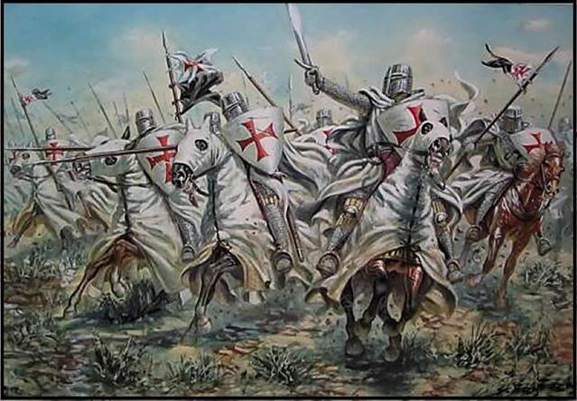

Slide 23
Second Crusade (1144-1149)
Muslims retook one of the crusader states
Bernard of Clairvaux preached
The Kings of France and Germany joined the crusade
But it failed
Bad relations with Byzantines
Lords of crusaders states didn’t want newcomers
Muslims got a new leader – Saladin
Took back Jerusalem
Third Crusade (1189-1192)
Richard the Lionhearted, later king of England
Couldn’t take back Jerusalem, but got Saladin to sign a treaty allowing Christians to visit

Slide 24
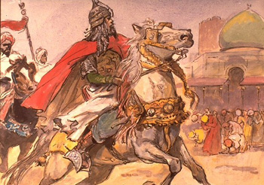

Slide 26
Other crusades
Not successful
Violent against each other more often than against Muslims
But did reduce number of quarrelsome knights in Europe
Gave Western Europe confidence that it did not always have to be on the defensive against Muslims
Hurt Catholic-Orthodox relations

