Slide 1
Bellwork 1/8/15
Using Lecture 18 (handed out on Tuesday), answer the question below in at least five sentences (a full paragraph):
How did Muslims (those who follow the religion of Islam) influence Western history?

Slide 2
The Rise of Islam
Threat to the West
Muhammad
Shi’ite vs. Sunni

Slide 3
At the height of Islamic civilization:
  Spain
  Sicily
  North Africa
  Egypt
  Palestine
  Syria

Slide 4
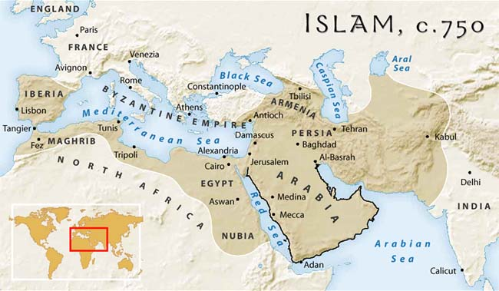

Slide 5
The Islamic religion and civilization was both:
  A threat to the West and Byzantium
  Also a source of ideas for later Western Europe
    Absorbed and preserved ancient Greek and Latin writings, translated into Arabic, which were later found by Western Europeans during the Renaissance

Slide 6
Islamic religion had elements of other religions:
  Christian
  Jewish
  Pagan

Slide 7
Islamic civilization tolerated others on several conditions:
  Recognize Islamic political rule and law
  Pay Islamic taxes
  Do not preach your religion among Muslims
But as time went on, Islam became more protective and intolerant
  Therefore, did not impact Western society as much as, say, Germanic culture did
  Instead, was strange and threatening

Slide 8
Islamic religion was formed by an illiterate culture
  So we know less about their beginning
  Vs. Christianity
Started on the Arabian Peninsula

Slide 9
Founder
  Muhammad
    570-632
    Born in Mecca
      All Arabs worshipped a large black stone there
    Not very wealthy
    Orphaned by 6
    At 25, married a widow of a wealthy merchant
      Became a social activist against:
        Materialism
        Paganism
        Unjust treatment of poor

Slide 10
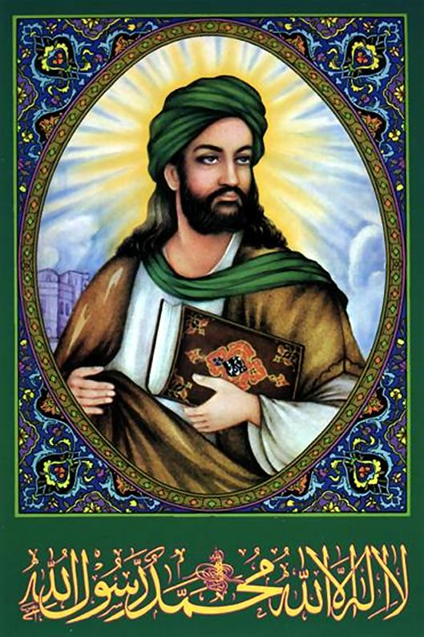

Slide 11
In 610
  At the age of 40, Muhammad received his first revelation and began to preach
  Believed God spoke to him through Gabriel
  These revelations are collected in the Koran
  Islam = submission to the will of God
  Believed he was the last in a long line of prophets starting with Noah
    Jesus was just one of the prophets
      Not co-eternal, or co-equal to God
      Like Judaism, monotheistic, not Trinitarian

Slide 12
Five Pillars of Islam
  Profession of Faith – there is no God but Allah, and Muhammad was the last prophet
  Prayers – uttered towards Mecca five times a day
  Giving of alms – charity to the poor
  Fasting – during certain times
  Pilgrimage – to Mecca, at least once in your life

Slide 13
Thought Jews and Christians had strayed from the real religion
  Not very successful in converting them to Islam
  Not accepted by the leaders of Mecca
  Left in 622 and went to Medina
    Called the hegira (breaking of former ties)
    Started a community with more rules
      No wine
      No gambling
      No usury
      New legal system
    Followers started to attack caravans on their way to Mecca
      By 624, army was powerful enough to conquer Mecca

Slide 14
Died in 632
  Had not named a successor
    Some selected Abu Bakr (wealthy merchant, Muhummad’s father-in-law) as caliph
    Later, Muhammad’s son-in-law became caliph
      When he died, a general became caliph and made the position hereditary for his family, creating the Umayyad dynasty
        Moved the capital from Medina to Damascus
        The Shi’ites would only accept descendents of Muhammad’s son-in-law
        Sunnis accepted Umayyads as true rulers
        = This division exists today

Slide 15
Made it a tradition to make raids on their enemies
  Called it the jihad (striving in the way of the Lord)
    Not meant to convert people
  636 – defeated the Byzantine army
  640 – Syria fell
  650 – the entire Persian empire was under Muslim control
  720s – Egypt, North Africa, and Spain were all under Muslim rule
  732 – Muslim expansion in Europe was stopped at the Battle of Tours, in France

Slide 16
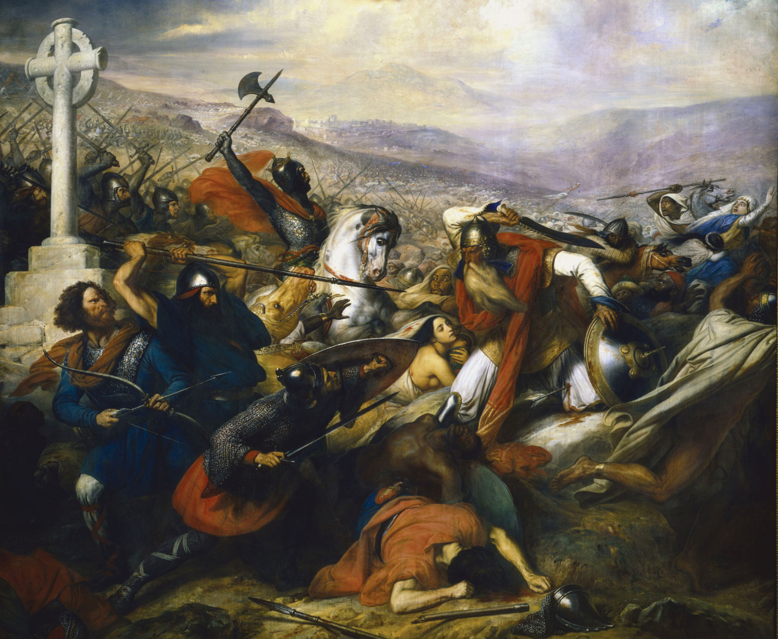

Slide 17
8th/9th Centuries = golden age of Islam
  Gathered Arabic, Byzantine, Persian, and Indian writings in their raids
  Translated them
  Commented on them
  Preserved them
  12th century (High Middle Ages) Westerners were re-exposed to this old literature
    Because the violent Early Middle Ages were over

