Slide 1
Bellwork Feb 17,2015
Get ready for class quickly and silently
Begin taking today’s notes when Miss Buccola flips to the next slide

Slide 2
Unit 9: Leaders, Artists, and the Age of Discovery
More specifics on the Renaissance, Reformation, and Enlightenment
15th – 18th centuries (1400s – 1700s)
The Age of Discovery
Christopher Columbus
Ferdinand Magellan
The Scientific Revolution
The Columbian Exchange
The Trade Triangle
The Colonization of America
Leaders
Joan of Arc
Queen Elizabeth I
King Charles I
Artists
William Shakespeare
John Milton
Georg Frederic Handel
Wolfgang Amadeus Mozart

Slide 3
Christopher Columbus (1451-1506)
1492 accidentally discovered the Americas
Claimed it all for Spain

Slide 4
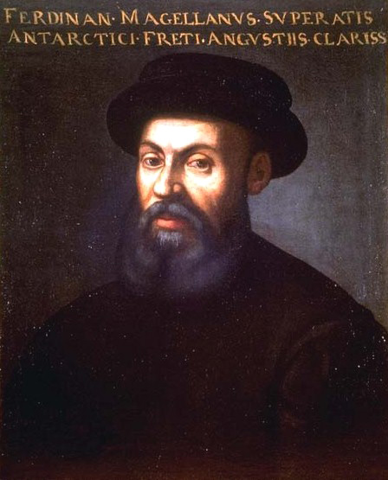
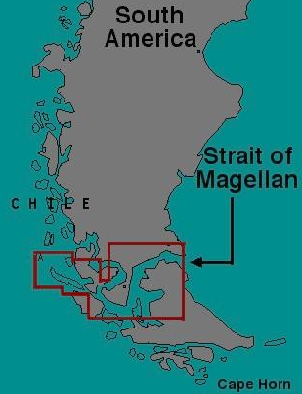
Ferdinand Magellan (1480-1521)
Portuguese explorer
First to circumnavigate the earth (1519-1522)
Helped Europeans more completely understand how much land Columbus had found
Showed Spain that they would have to do more to be able to claim ALL of what Columbus found
Showed the other European powers that they could have a bit of the new discoveries too
He died in a battle in the Philippines before the rest of the crew got home
Strait of Magellan is named after him

Slide 5
The Scientific Revolution
From 1543
The publication of Copernicus’ Revolutions of the Heavenly Spheres
Completely new ways of thinking about the physical world
Gravity
Heliocentrism
New technologies
To the end of the 18th century (1800s)

Slide 6
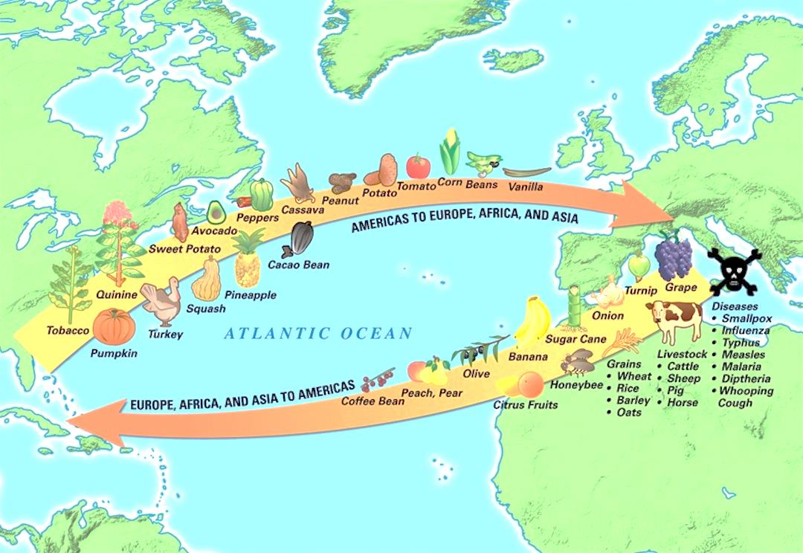
The Columbian Exchange
From 1492
Columbus’ accidental discovery of two new continents
To the 18th century
The trade of goods, people, and diseases between the “Old World” and the “New World”

Slide 7
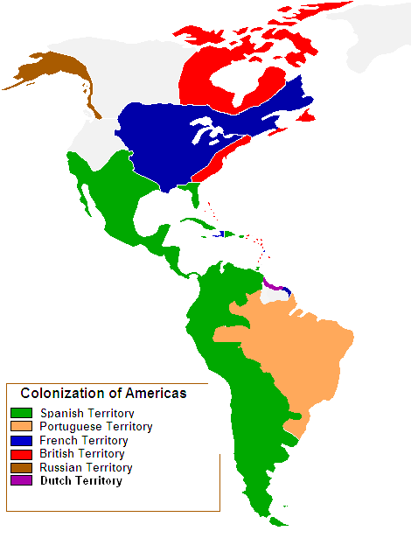
The Colonization of the Americas
From 1492
When Columbus accidentally discovered the two continents
Spain, France, England, Portugal, and others competed for space in the two continents
To 1776
When the thirteen British colonies in America declared their independence
Or to 1803
When Napoleon sold France’s American colonies to the United States
Or to 1898
When Spain ceded its last colonies to the United States

Slide 8
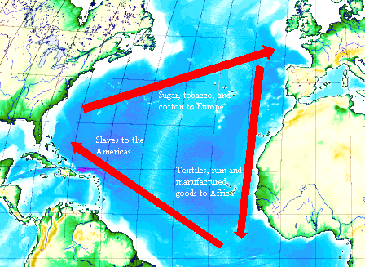
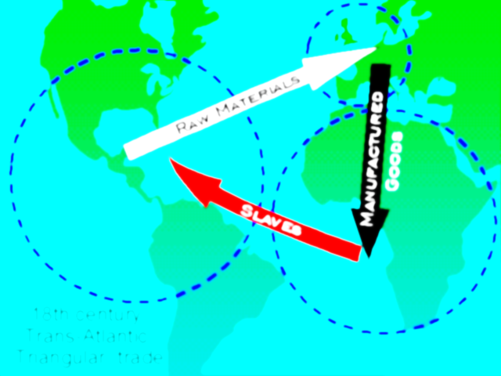
The Trade Triangle
From the late 16th century
When colonization of the Americas required slave labor
To the early 19th century
When William Wilberforce and the rest of the Clapham Sect convinced Britain to abolish their slave trade
Trade between the Old World and the New World, with a stop off in Africa to pick up slaves

Slide 9
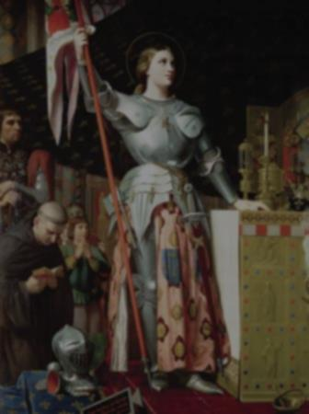
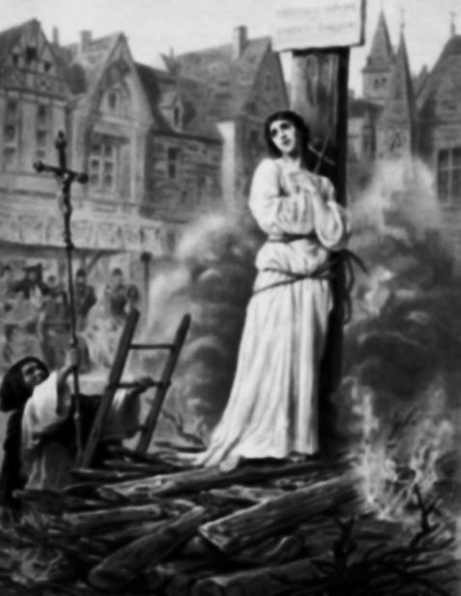
Joan of Arc (1412-1431)
French peasant girl
Born during the Hundred Years’ War between France and England
English kings had owned parts of France since 1066
Had visions about what France should do to defeat the English and get the proper king on the throne of France
Trusted by a few important generals
Led French armies to major victories
Jealous generals pointed out that most people should not believe a peasant girl could be hearing from God
Burned at the stake at age 19, accused of witchcraft

Slide 10
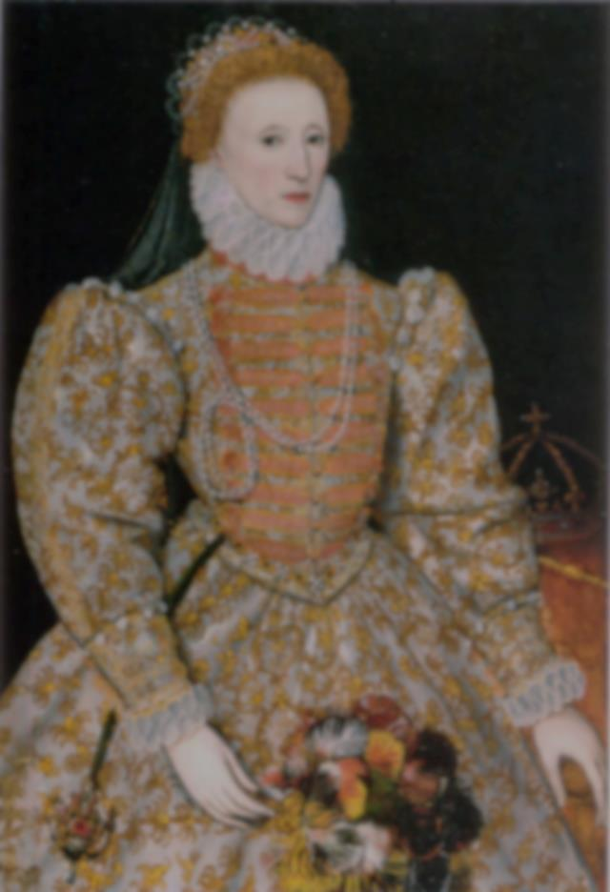
Queen Elizabeth I (1533-1603)
Daughter of Henry VIII
Declared illegitimate by Catholic heirs to the throne
Imprisoned by her half sister
Eventually became queen
Established the Anglican Church better
Defeated the Spanish Armada
Or, really, a storm in the English Channel did
Made sure Spain would not be the leading European and colonial power, but England would
Called “The Virgin Queen” because she never got married or had children
The State of Virginia is named after her

