Slide 1
Bellwork Feb 2, 2015
Using the quote from Alexander Pope in the fifth paragraph on the second-to-last page of the packet, answer the question below in at least five sentences (a full paragraph) –
How was what Alexander Pope wrote an Enlightenment-era thought?

Slide 2
Quiz Feb 2, 2015
What were the dates of the “Long 18th Century”?
What revolution stimulated the Enlightenment?
What is the other name given to the Age of Enlightenment?
Which two countries killed their kings during the Enlightenment era?

Slide 3
Grading the Quiz
1685-1815
The Scientific Revolution
The Age of Reason
France and England

Slide 4
Notes Feb 2, 2015
The Enlightenment, or the Age of Reason
1650s-1800
Came from the Renaissance and the Scientific Revolution
Increasing focus on mankind rather than God
Success of logic and observation rather than faith
If breakthroughs could be made in science and discovering land, then they could be made in politics, philosophy, religion, etc.
European opinions about religion, philosophy, science, government, etc. changed
From faith to reason
From supernatural, fatalistic view of human history to natural, optimistic view of human history
Even Renaissance people loved learning from the past, but Enlightenment people do not

Slide 5
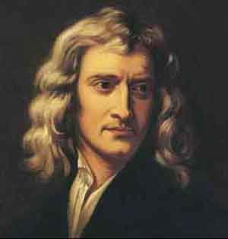
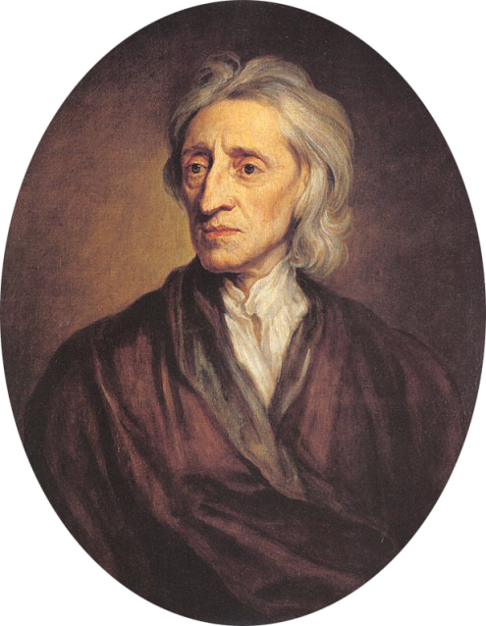
Early Enlightenment (1650s-1730)
Galileo
Defended Copernicus’ idea that the earth moved around the sun, contradicting what people thought the Bible said
Isaac Newton (English physicist)
Discovered the Law of Gravity
Precise measurements
John Locke (English doctor and philosopher)
Human nature was changeable
Knowledge is gained through experience, not by understanding eternal truth

Slide 6
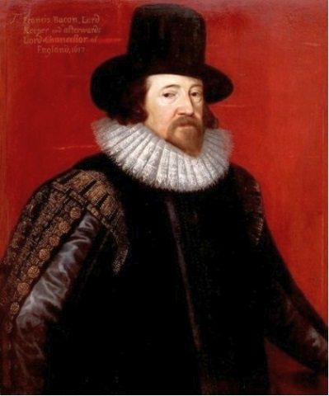
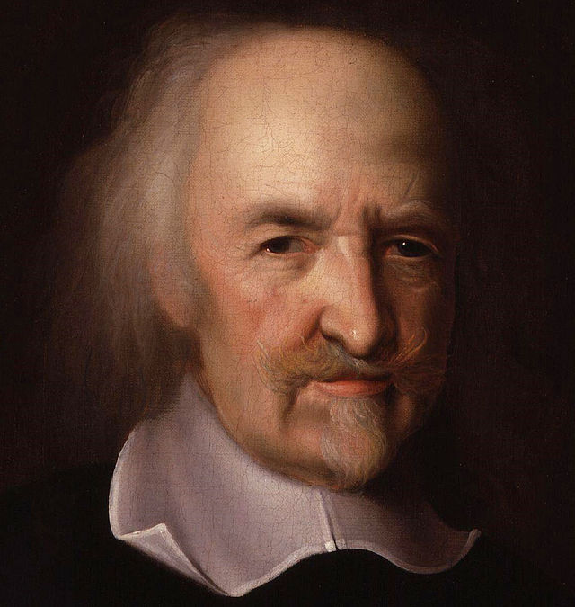
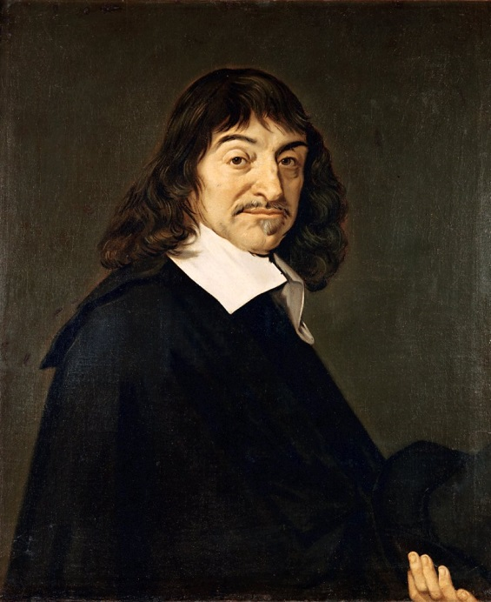
Francis Bacon (English politician)
Developed the “scientific method”
Careful observation, questioning, testing
Thomas Hobbes (English philosopher)
Developed “social contract theory”
Believed government was created by society making a contract with itself, not that God had appointed government, like medieval people had thought
John Locke later expanded on Hobbes’ ideas
Rene Descartes (French philosopher)
Said one should question EVERYTHING
Don’t even trust your own senses
Purposely tried to disagree with all philosophers before him

Slide 7
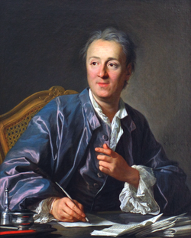
High Enlightenment (1730-1780)
Philosophes
French philosophers and others who discussed the ideas of the day
Would meet at salons
Coffeehouses, hosted by aristocratic ladies, where people would discuss ideas
Denis Diderot
Put together the first encyclopedia
He and other Enlightenment thinkers thought that everything in the universe could be demystified, thought about logically, and catalogued

Slide 8
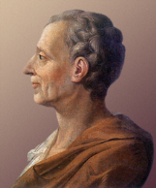
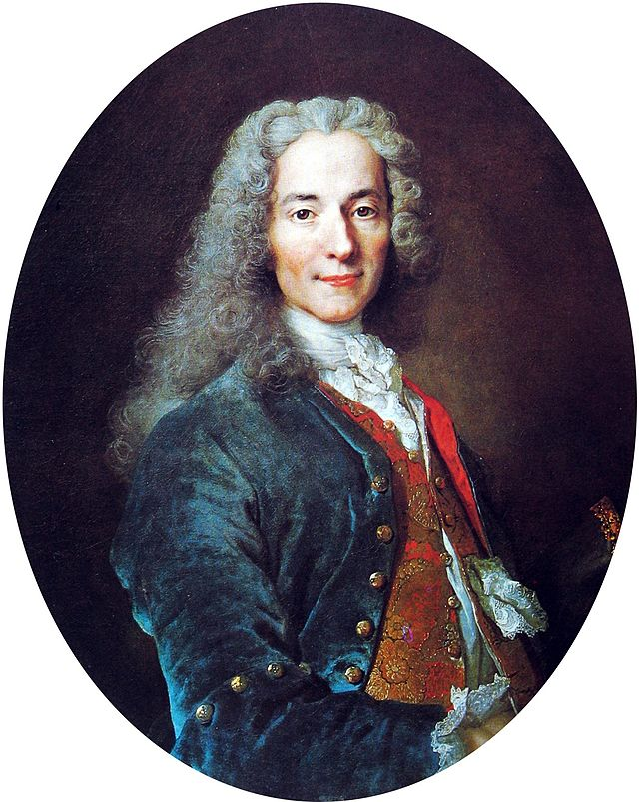
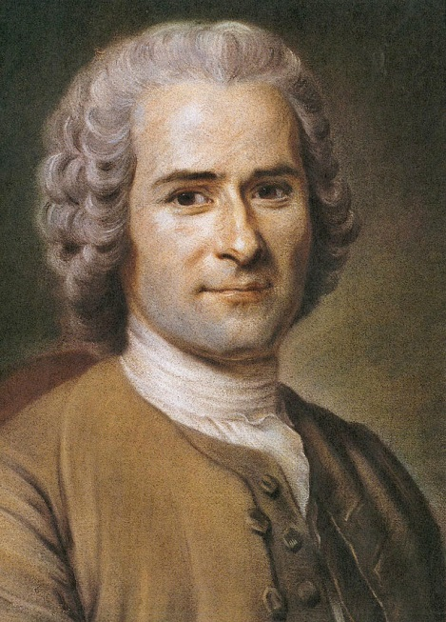
The Baron de Montesquieu
Wrote “The Spirit of the Laws”
Power in government should be separated to prevent anyone taking all power and using it badly
Voltaire
Wrote stories that expressed the ideas of many Enlightenment philosophers
Attacked Catholic Church
Harsh humor
Jean Jacques Rousseau
Kind of an Enlightenment thinker, kind of a challenger
Thought people were naturally good, and bad people had been corrupted by society

Slide 9
7th Grade Feb 3, 2015
Hi Mrs. Jarman!
Below are the slides the 7th graders in 2nd and 4th hour should copy into their notes.
They may ask questions about the material, so if you can’t answer them, just tell them to write their questions down to ask me on Thursday.
Thanks!

Slide 10
The Baron de Montesquieu
Wrote “The Spirit of the Laws”
Power in government should be separated to prevent anyone taking all power and using it badly
Voltaire
Wrote stories that expressed the ideas of many Enlightenment philosophers
Attacked the Catholic Church with his harsh sense of humor
Jean Jacques Rousseau
Kind of an Enlightenment thinker, kind of a challenger of Enlightenment-era ideas
Thought people were naturally good, and bad people had been corrupted by society, not by themselves

Slide 11
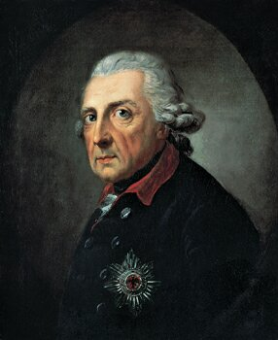
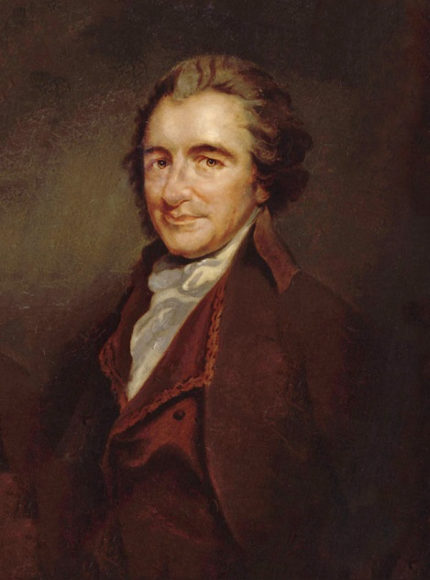
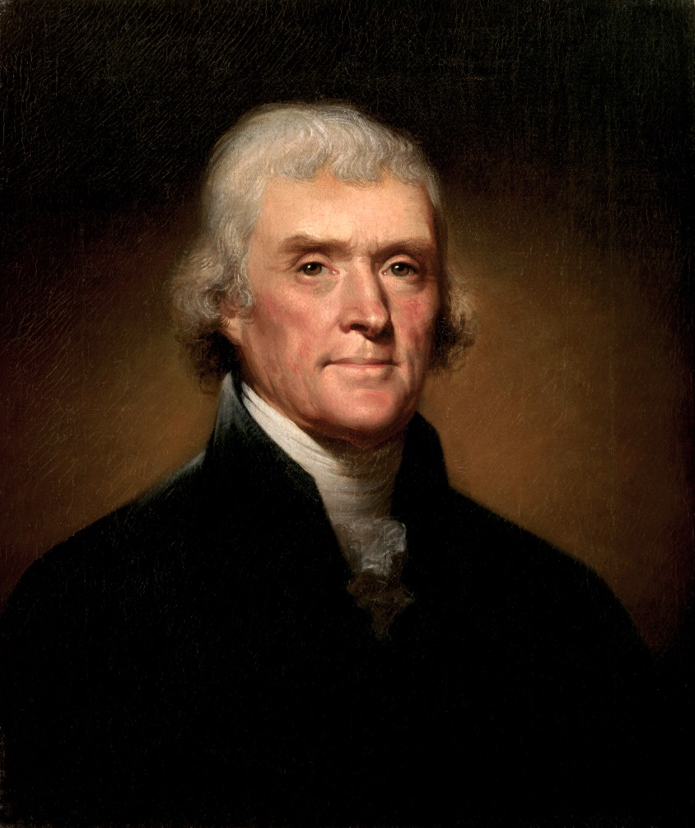
Enlightened rulers
Called Enlightened Despots or Enlightened Absolutists
Frederick the Great of Prussia (picture on right at top)
American revolutionaries
Thomas Paine (picture left)
Thomas Jefferson (picture below)
Imitated John Locke’s ideas

Slide 12
John Locke
Wrote to justify the “Glorious Revolution” of 1688
The English people asked their king’s daughter and son-in-law to come throw him out and become king and queen
Expanded Hobbes’ “Contract Theory” of government
Governments had always been set up by people needing a higher power to keep them at peace, not by God
Since people, not God, had created government, one could say that there is a contract between any people and their government
If the government ever did not do what the people had created it to do, then the government had broken the contract
If the government breaks its contract with the people, it is the duty of the people to overthrow and replace that government
Huge influence on the American Revolution

Slide 13
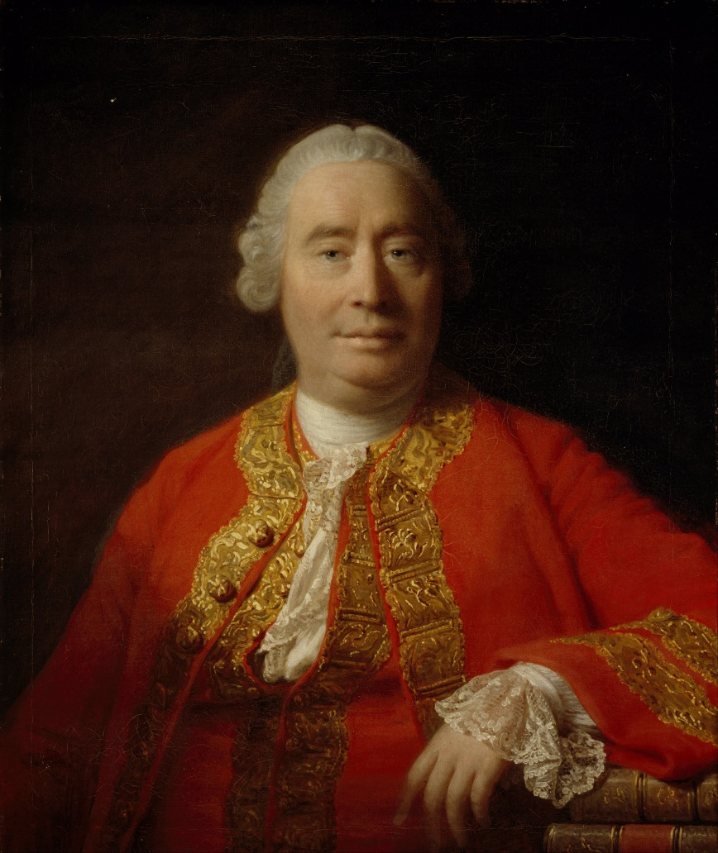
David Hume (Scottish historian)
Challenged many Enlightenment ideas
Said people are too driven by needs and desires to be able to be as reasonable as many Enlightenment thinkers thought they could be

Slide 14
Late Enlightenment (1780-1815) and results of Enlightenment thinking
Caused revolutions
Caused the rise of the first modern dictator, Napoleon Bonaparte
Some began calling for women’s rights
The West became intensely concerned with reason, thinking, logic, rationality, etc.
Western religion changed as well

Slide 15
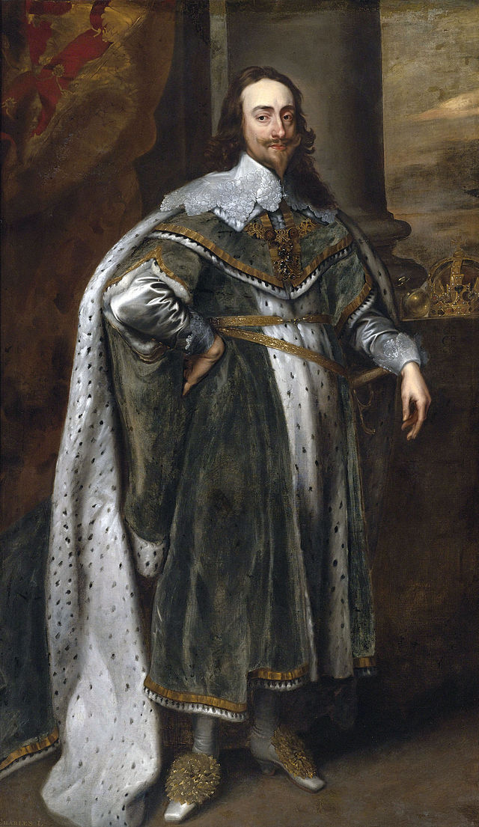
English Civil Wars (1642-1688)
Protestants in England were upset that the Anglican Church seemed so Catholic
Tried to purify the church of Catholic things, so people called them the Puritans
King Charles I wasn’t listening to the Puritans, so they declared war on him
The Puritan Parliament vs. Anglican Royalists
The Puritans lost the first civil war, but won the second and beheaded Charles in 1649
Can see from these wars that the English agreed with the Enlightenment idea that people can overthrow their government

Slide 16
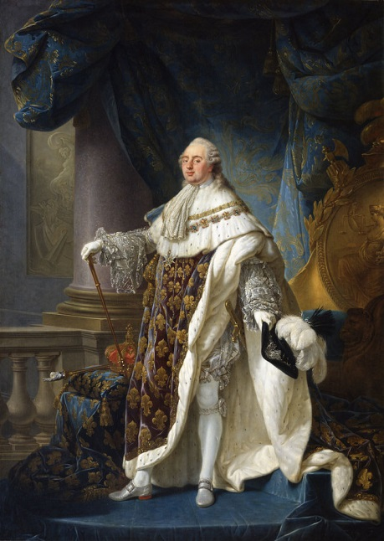
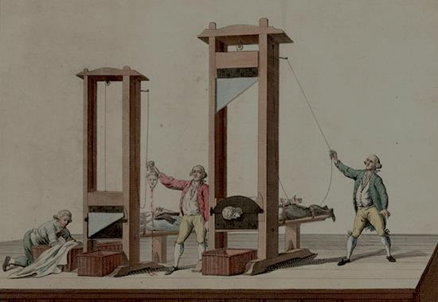
The French Revolution (1789-1799)
The people were tired of high taxes, high food prices, and the king not doing anything about it
The people revolted, and guillotined King Louis XVI and his wife, Marie Antoinette, in 1794
Here the French show that they agreed with the Enlightenment ideas that humans had natural rights that the government should protect, and if the government did not, the people could overthrow their government
The Revolution turned very bloody
Two years of it are called The Reign of Terror
And at the end, the French people turned to Napoleon to get them out of the mess, and he became a dictator
So Enlightenment ideas didn’t work very well

Slide 17
Five results of Enlightenment thinking
Westerners began to believe that natural laws (such as gravity, etc.) governed the universe rather than God
Westerners began to believe that humans were born with natural rights (as opposed to the medieval idea that humans only have responsibilities, not rights)
Westerners began to believe that humans would endlessly progress in knowledge, making society better and better, more and more moral

Slide 18
Westerners began to believe that God was the Great Architect and Designer “in the beginning,” but was not involved in day-to-day events
They thought thinking of God as only the Creator was a more logical way of thinking
The discovery of natural laws like gravity seemed to prove that there was no need to fear a god, natural laws were running everything
This new religious idea was called Deism
Deists called God “the Great Watchmaker” – He made the universe and wound it up like a clock and set it down and let it go, never touching it again
Thomas Jefferson was a Deist
Rulers attempted to become more “enlightened”
Like Frederick the Great of Prussia
Were supposed to care more for their people than kings had before

Slide 19
This ends 7th grade notes for Tuesday
If they finish early, give them time to read and annotate the packet for the Socratic Seminar on Thursday (on my desk with a green tab on it).

Slide 20
Bellwork Feb 5, 2015
Prepare for our Socratic Seminar
Read and annotate the packet
Prepare for questions such as
How did John Locke prove his opinion that the human mind is blank when one is born?
How did John Locke think government started? Who thought of it first?
How did Jean Jacques Rousseau think that governments came into existence?
How did the Americans think a government should look and act, and what kind of rights did they think people had?

Slide 21
Bellwork Feb 6, 2015
Choose one of our Socratic Seminar questions from yesterday and write a one-paragraph answer:
How does John Locke’s opinion that humans are born without a set nature compare to opinions about human nature expressed before his lifetime?
How does John Locke’s opinion on government compare to opinions on government before his lifetime?

