Slide 1
Bellwork Feb 23,2015
Using your Charles I handout, answer the question below in at least five sentences (a full a paragraph) –
Why did the English feel they needed to kill King Charles I?

Slide 2
Quiz Feb 23,2015
What were the years of Charles I’s reign?
What version of Christian was Charles I?
In what year was the Second English Civil War?
To many, Charles was seen as a _________ for his people, and some people lay wreaths at his statue.

Slide 3
Grading the Quiz
1625-1649
Anglican
1648
Martyr

Slide 4
Video Quiz Feb 23,2015
In what year did Spain attempt to invade England?
Why did the Spanish hate the English during Elizabeth I’s reign?
How did ships sail INTO the wind?
What did Sir Francis Drake do on the night after the first battle?

Slide 5
Grading the Quiz
1588
England was Protestant
By zig-zagging
He looted one of the disabled Spanish ships

Slide 6
Bellwork Feb 24,2015
Using your English Civil War handout, comparing the paragraph that starts at the bottom of page 2 and the second full paragraph on page 5, answer the question below in at least five sentences (a full a paragraph) –
What was the difference between the “divine right of kings” and the theories that supported Cromwell’s “New Model Army”?

Slide 7
Quiz Feb 24,2015
The English Civil War was both religious and __________, as well as social and economic.
Which English king wrote A Trew Law of Free Monarchies: Or the Reciprock and Mutual Duetie Betwixt a Free King, and his Naturall Subjects in 1597?
Of what did the Puritans want to purify the Anglican Church?
Who became English king in 1660?

Slide 8
Grading the Quiz
Political
James I
Of Catholic-seeming things
Charles II

Slide 9
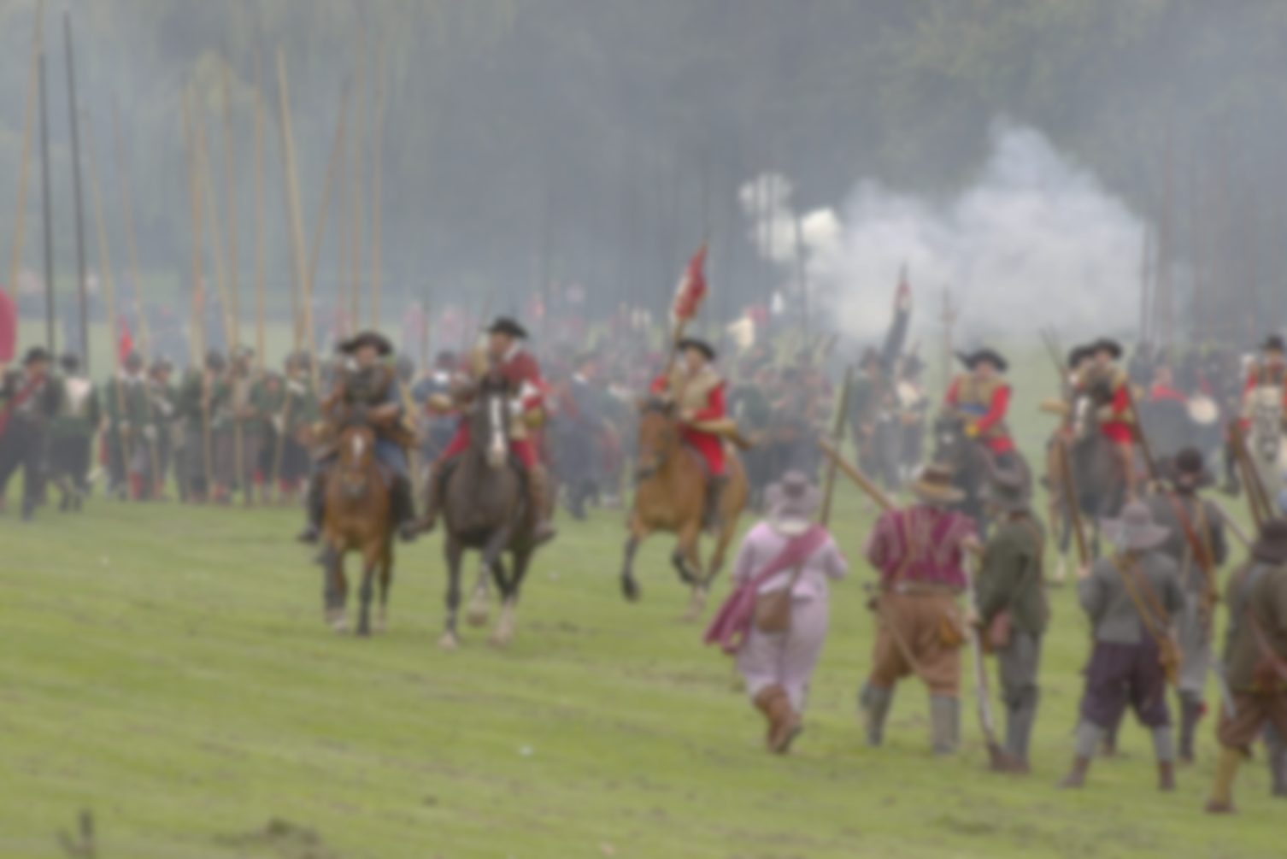
The English Civil Wars
A fascinating period of a parliamentary monarchy’s history in which they
lacked a parliament for eleven years
did not have a monarch for nine years
Religious differences
England had pulled out from under the Catholic Pope in 1536 under Henry VIII
But the Anglican Church was still very Catholic-like, though seemingly Protestant
Some “Puritans” wanted to purify the English church of Catholicism
= Anglican Protestants v. Puritan Protestants v. Catholics
1642-1688
Three civil wars and one “Glorious Revolution”

Slide 10
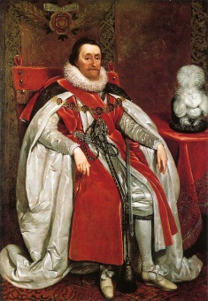
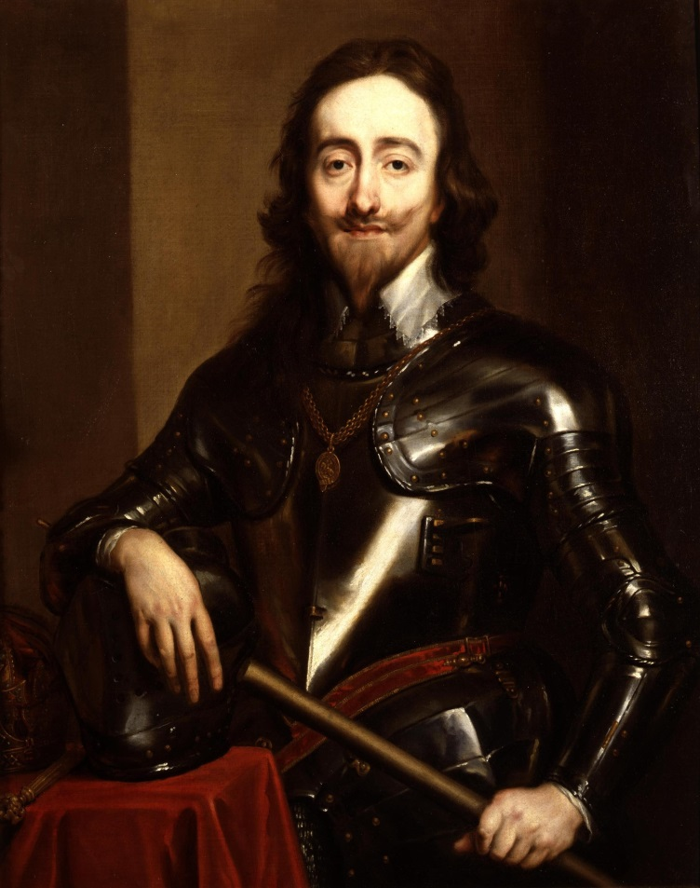
James VI of Scotland -> James I of England
Unified Scotland and England
Financial troubles, Parliament gets used to refusing the king’s will
Managed the Protestant v. Protestant v. Catholic situation pretty well
Charles I
Signed the Parliament’s Petition of Right, then dissolved Parliament
Personal Rule, 1629-1640
Ruled without calling Parliament for eleven years
Beheaded 1649

Slide 11
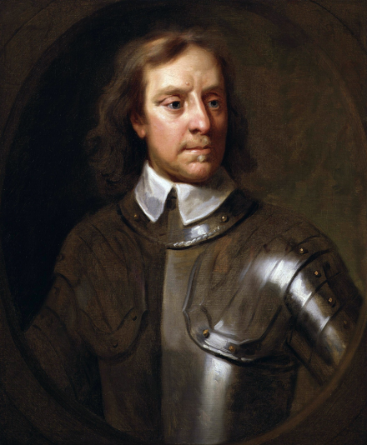
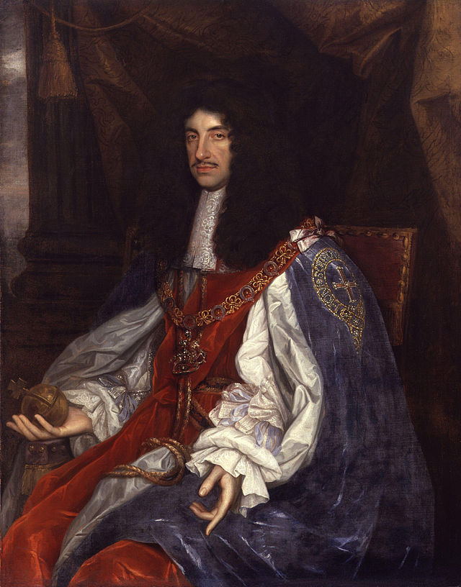
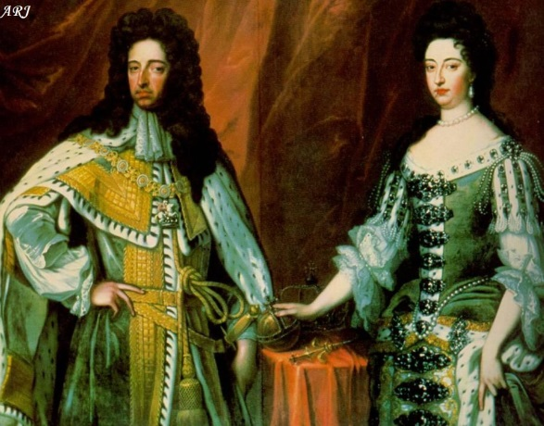
Oliver Cromwell
Puritan member of Parliament, important general for the Parliamentary Forces
Lord Protector, 1653-1658
Just as tyrannical as Charles I, if not more so
Charles II
Saw his father beheaded
Spent formative years in exile in France
Convinced by English nobles to restore the monarchy
Looked too pro-Catholic
His Protestant daughter Mary had married William of Orange, a Dutch noble
William and Mary
“The Glorious Revolution”
English nobles invited them to come replace Charles II

Slide 12
[DON”T WRITE] The groups in the Civil Wars
Puritans (Levellers) – equality of rights and conditions
Soldiers/Officers – decent living for all
Anabaptists – communists
Ranters – anarchists
Diggers – collectivists
Fifth Monarchy men – utopians awaiting the Second Coming
George Fox and the Friends (later Quakers) – egalitarians
Millenarians – wanted to establish the New Jerusalem
Familists – love inspired by faith, no laws or ranks
Muggletonians – followers of a preacher
Brownists – followers of a preacher

Slide 13
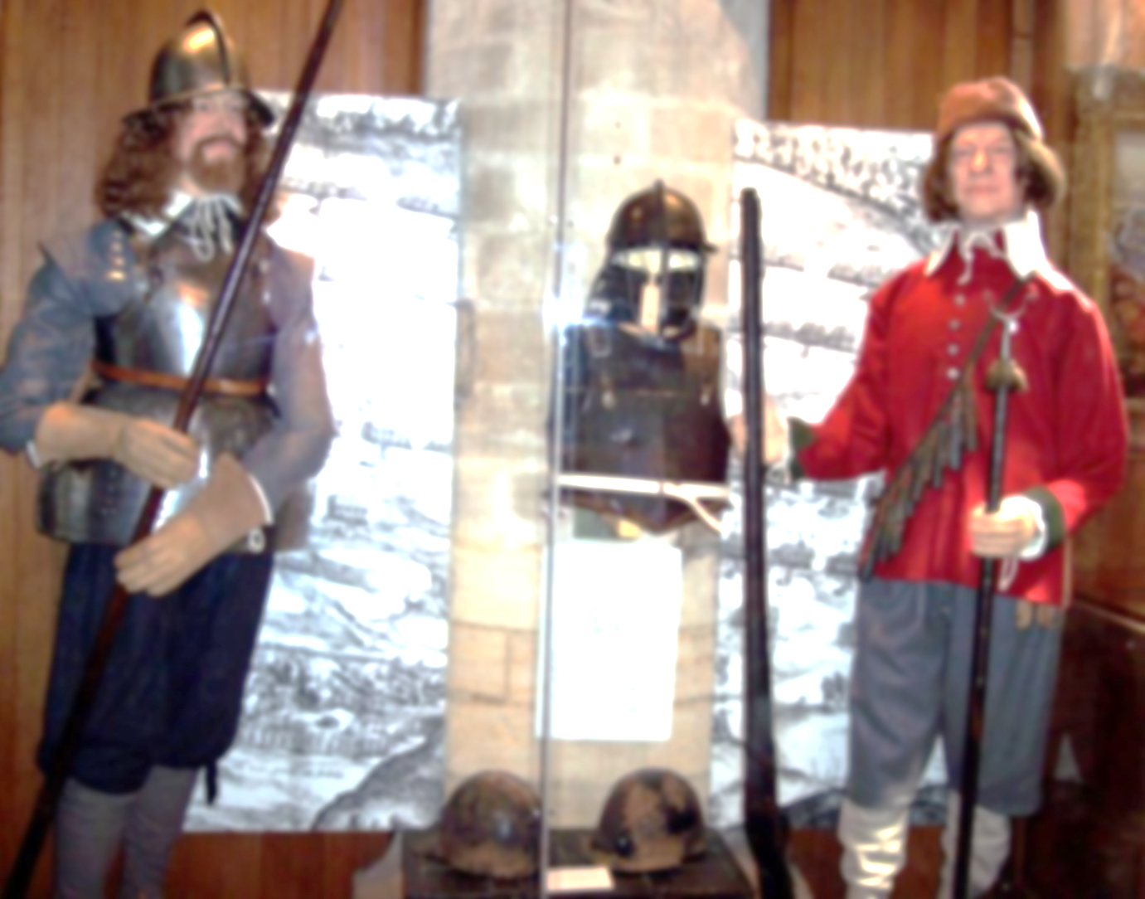
Royalists/Cavaliers
Anglican
Saw themselves as trying to save king and church, law and order, tradition and property
Parliamentarians/Roundheads
Presbyterian
Independent/Puritan
Saw themselves as doing God’s work
Quite violent
As with all civil wars, civilians were killed
Towns besieged
Starvation
200,000 = 2.5-3% of population killed

Slide 14
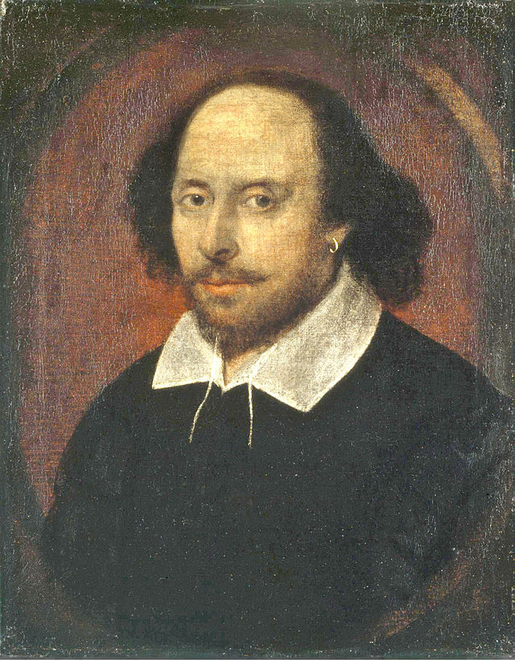
William Shakespeare (1564-1616)
English poet and playwright
38 plays
Histories
Henry V
Tragedies
King Lear
Romances (or tragicomedies)
The Tempest
Comedies
The Comedy of Errors
154 sonnets
His plays have been translated into every major living language
Performed more often than any other playwright

Slide 15
Bellwork Feb 26,2015
Using your History of Music handout, answer the question below in at least five sentences (a full a paragraph) –
Which composer is your favorite and WHY?

Slide 16
Quiz Feb 26,2015
What were the names of the two kings for whom Handel wrote Water Music and Music for the Royal Fireworks?
How many instruments play chamber music?
Who was the child prodigy?
On what piece was Mozart working when he died in 1791?

Slide 17
Grading the Quiz
George (I and II)
Between 1 and 4
Mozart
Requiem

Slide 18
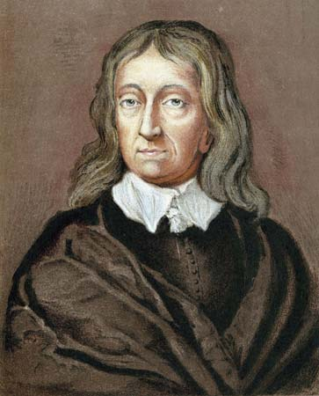
John Milton (1608-1674)
Poet and politician
Worked for Oliver Cromwell
Wrote political pamphlets and defenses of the Puritan cause
Wrote Paradise Lost
A depiction of the fall of Satan and Adam and Eve

Slide 19
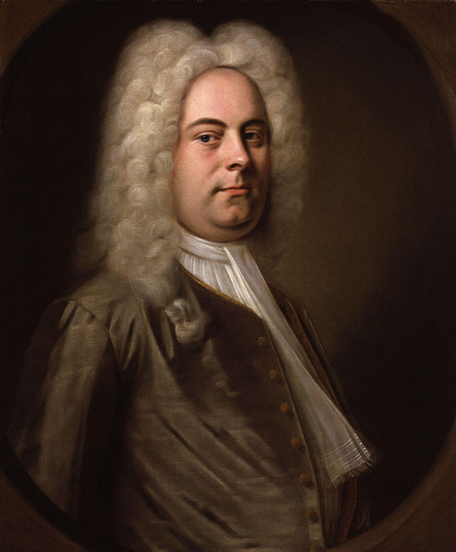
Georg Frederic Handel (1685-1759)
German-born, but spent most of his life in London
Changed his name to sound more English
Baroque composer
Oratorios
Messiah written in 24 days, prophecies of Jesus and their fulfillment
Operas
More than 60
Organ concertos
Other pieces
Water Music to welcome the King of Hanover to England as George I
Coronation pieces used since then at every English king’s crowning

Slide 20
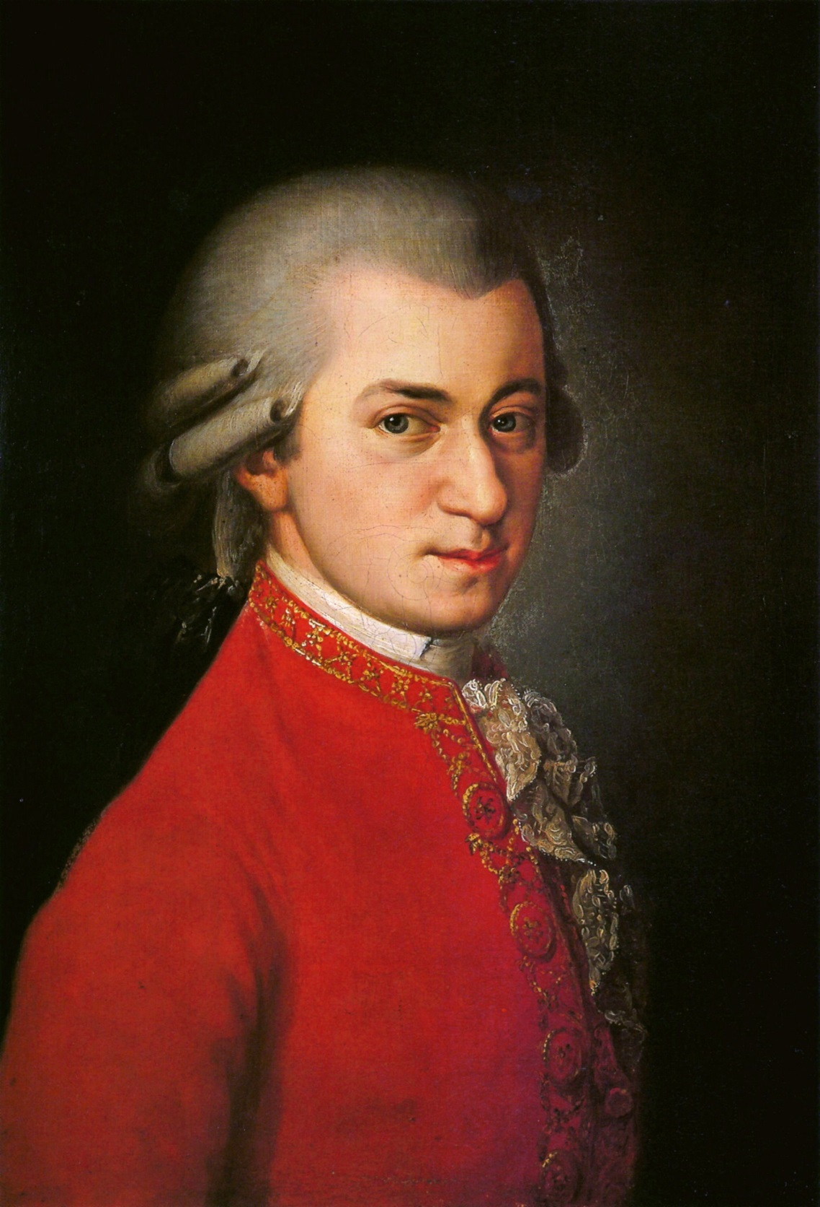
Wolfgang Amadeus Mozart (1756-1791)
German composer of the Classical era
Composed over 600 works
Seen as the pinnacle of symphonic, concertante, chamber, operatic, and choral music
Went through crazily popular times, but died penniless at age 35
In the middle of writing his most famous Requiem
Managed money badly and allowed his youth to offend people

Slide 21
Prepare for our Socratic Seminar on the Age of Discovery
Read and annotate Christopher Columbus’ letter to Sant Angel, looking for answers to questions like these:
Why did Columbus choose those names for the various islands?
Why did Columbus and other like him go exploring?
How did Europe respond to what Columbus and other discoverers found?

