Slide 1
Bellwork 4-20-15
Using your notes and anything Miss Buccola has said about the Treaty of Versailles (the treaty that ended WWI), answer the question below in at least five sentences:
Did the Treaty of Versailles CAUSE the Second World War? If so, how? If not, why not?

Slide 2
Bellwork 4-21-15
Using the last paragraph on Barzun’s page 749, answer the question below in at least five sentences:
Why were Albert Einstein’s Theory of Relativity and Sigmund Freud’s new psychology so attractive to the generation that had just lived through WWI?
NOTE [you don’t need to write this down]: Relativity = the absence of standards of absolute and universal application.
NOTE [you don’t need to write this down]: Freud’s psychology = unconscious sexual drive

Slide 3
Video Quiz 4-21-15
What was the title of the “documentary” (it was a propaganda film made by Hitler’s men)?
In what year was the “documentary” made?
What was the opening scene of the “documentary” after all the fancy lettering?
Name a mannerism Hitler used while speaking.

Slide 4
Grading the Video Quiz
The Triumph of the Will
1934
Clouds (Hitler flying to Nuremburg)
Shouting, folding arms, half-heil salute, etc.

Slide 5
Embracing the Absurd
American higher education took on more vibrancy
Returning WWI vets brought mature minds to campus
Acceptance of arts as an academic subject
Dictatorships and armed communist governments
Spread throughout Europe
Karl Marx’s prediction capitalism would collapse and bring about the rulership of workers seemed to come true in the Great Depression
Lenin and Stalin in Russia set up a government that would be responsible for at least 60 million deaths by 1990

Slide 6
Vichy France
Third Republic, set up after WWI, based in Vichy
Surrendered to Hitler in 1940
To save Jews and others from being sent to factories/camps in Germany
Nazis actually did treat France a little better than others
Resistance movements continued in South
Many considered Vichy officials traitors
After Germany and Japan surrendered
Western governments became welfare states
Political differences become tiny, between sizes of big government

Slide 7
Survivors of the Great Illusion became pacifist
Einstein’s theory of relativity and Freud’s psychology were favorite ideas
Relativity: there may be no absolutes
Psychology: unconscious, irrational, sexual driver of mankind
New scientific work became less and less understandable by the average person
Atomic work raised ethical questions: should scientists work at projects for destruction?
Germans develop rocket engineering during WWII, Russians put first satellite, Sputnik, into orbit in 1957
Britain terrified of war again, France still terrified of Germany

Slide 8
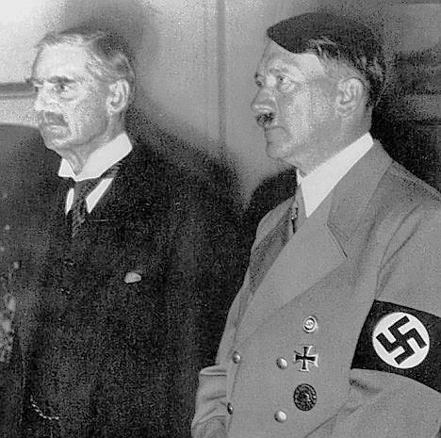
Appeasement
Once Hitler came to power in 1933, Germany began disobeying the Versailles Treaty
Rebuilt army, navy, air force
France saw and tried to alert the world to it
Britain didn’t want to pressure Germany because it feared war again
Neville Chamberlain, British Prime Minister, 1937-1940
Met with Hitler several times
Let Hitler take various zones he wasn’t supposed to have
Said he agreed with Hitler that Germans only needed Lebensraum because of how they’d been restricted by Versailles

Slide 9
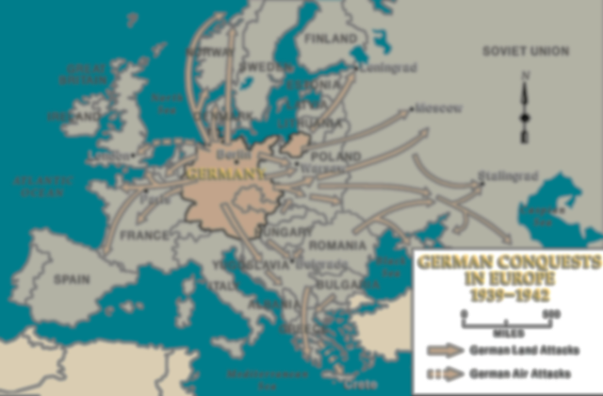
WWII
1939-1945
Started when Hitler invaded Poland in September 1939
Had already invaded Sudetenland and Austria in 1938, Czechoslovakia in 1939
Chamberlain had done nothing, although Winston Churchill had warned him of Hitler’s aims, laid out in Hitler’s book Mein Kampf, written in jail in the 1920s
Britain and France declared war
Feared yet another Napoleon situation
Only some knew about the anti-Semitism

Slide 10
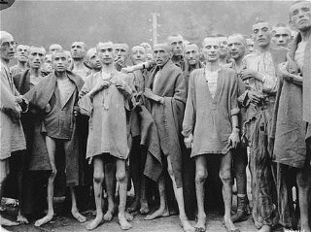
Holocaust
Not that weird for that time
People groups in the Austrian and Ottoman Empires had been slaughtering each other for centuries
Even Americans in 1920s thought of various people groups as less evolved and not worthy to have kids
But intensity and scale of Hitler’s program made such treatment of minority groups unpopular
6 million Jews, and 1 million others, killed within 6yrs
Many others starved, made insane, etc.

Slide 11
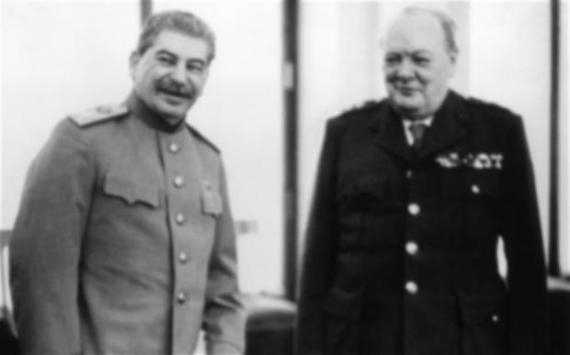
Winston Churchill
British Prime Minister, 1940-45 / 1951-55
Knew his enemy, would not give up, inspiring
Helped lead Allies to victory in WWII
Joseph Stalin
General Secretary of Communist Party, 1924-53
Responsible for at least 60 million deaths worldwide because of the spread of communism
Was on Allied side during WWII, then our enemy until 1990

Slide 12
Socratic Seminar 4-22-15
Read each of the below documents and take notes.
The Nazi Program (page 303)
Now I Know Which Road to Take (page 317)
I Had Given Him My Heart (page 317)
Czechoslovakia Has Ceased to Exist (page 327)
I Bitterly Regret What Has Now Occurred (page 328)
Alone (page 334)
The Battle of Britain (page 334)
London Aflame! (page 335)
The Jewish Peril (page 340)
Not A Single Jew (page 341)
A Complete Solution to the Jewish Questions (page 345)
The Wannsee Conference (page 346)
Genocide (page 348)
Nazi Medical Experiments (page 352)
The Destruction of Hiroshima (page 364-366)

Slide 13
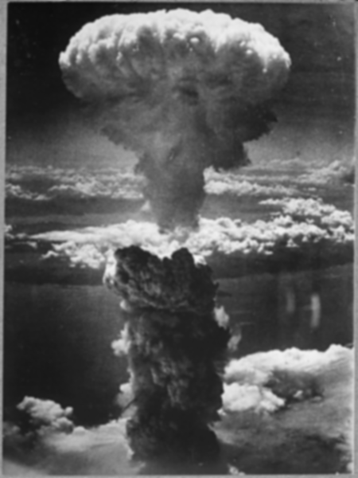
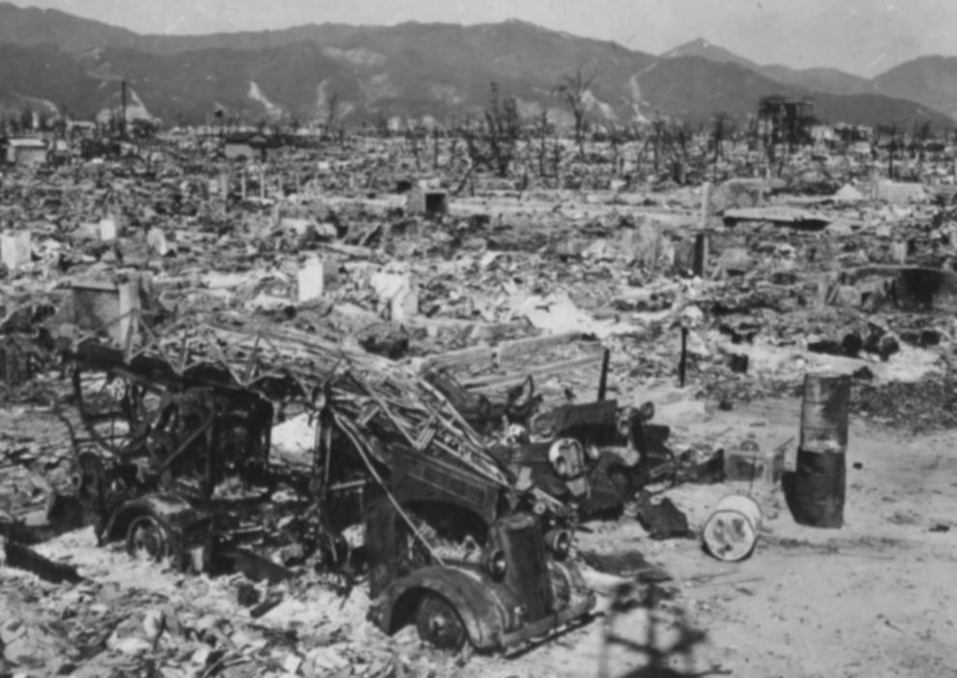
German surrender
May 7, 1945
Nuremburg Trials
13 trials between 1945 and 1949
Major war criminals, doctors, etc. involved in Holocaust
Japanese surrender
After two nuclear bombs (Hiroshima/Nagasaki)
Would not have given up fighting the U.S., thought surrender less honorable than death
75,000 people died
September 2, 1945

Slide 14
Result of two world wars: embracing the absurd
Soren Kierkegaard’s work became accepted
Danish theologian
1813-1855
Didn’t like Hegel’s conception of universe as reasonable, well-ordered
Thought there was an unbridgeable gap between God and man in his troubled world, requiring humble individual worship
Taken by many after WWII to mean that God does not actually have a purpose for man, there is no afterlife
Embrace the absurd, the madness of the 20th century, the inability of man to direct the course of civilization, etc.
But, oddly, many embraced Marxism as well (pre-determined history, capitalism WILL fall, man’s free will not influential, etc.)

Slide 15
Socratic Seminar 4-24-15
Review the documents and your notes from Wednesday.
What was it that the Nazis wanted?
The Nazi Program (page 303)
How did Hitler come to power?
Now I Know Which Road to Take (page 317)
I Had Given Him My Heart (page 317)
How did Hitler justify his invasions of other countries?
Czechoslovakia Has Ceased to Exist (page 327)
How did Chamberlain feel in 1939?
I Bitterly Regret What Has Now Occurred (page 328)
What was Britain’s experience of WWII, and how did Churchill inspire the Brits?
Alone (page 334)
The Battle of Britain (page 334)
London Aflame! (page 335)
How did Hitler convince Germans to hate the Jews?
The Jewish Peril (page 340)
How did the Jews defend themselves?
Not A Single Jew (page 341)
What was the Final Solution?
A Complete Solution to the Jewish Questions (page 345)
The Wannsee Conference (page 346)
Genocide (page 348)
Nazi Medical Experiments (page 352)
Must wait for debate…
The Destruction of Hiroshima (page 364-366)

