Slide 1
Bellwork 4/6/15
Today we will discuss the era of nationalism. Write down these definitions of nationalism:
A spirit or aspirations common to the whole of a nation.
Devotion and loyalty to one's own country; patriotism.
The desire for national advancement or political independence.
The policy or doctrine of asserting the interests of one's own nation viewed as separate from the interests of other nations or the common interests of all nations.
Now put nationalism in your own words.

Slide 2
Unit 11: Nationalism and the World Wars
1850s-1945
The Era of Nationalism
1850s-1914
Grew out of industrialization, into WWI
The First World War
1914-1918
Grew out of nationalism, and many other things
The Second World War
1938-1945
Grew out of WWI, and many other things

Slide 3
Nationalism
Nation = a people group, united by a common language or shared race or shared ideas
Note: a nation is not necessarily a country with a government
Eg. Cherokee nation
QUICK RESPONSE: What are some other examples of nations? What are some examples of countries made up of several nations? Is the United States a nation?

Slide 4
Germany led the way in nationalism
Otto von Bismarck
Prince of Prussia, 1862-1871
Engineered a series of wars that united the many German states, such as Bavaria, Saxony, etc. into one German empire
Chancellor of Germany, 1871-1890
Continued to build the German nation’s unity and power against other countries through treaties and other negotiations
Germany began to acquire colonies in Africa and Asia, like Britain, France, and Russia were
The rest of Europe was worried about this new power – how quickly would they industrialize and beat other European navies, armies, colonies, etc.?
Germany began to compete with Russia for who would gobble up the Ottoman Empire when it fell apart
Turkey, “The Sick Man of Europe”

Slide 7
Bellwork 4/7/15
During yesterday’s discussion of nationalism, Miss Buccola said that the growth in nationalism around 1850 could have been caused by industrialization.
How might nationalism in 1850 have been caused by industrialization since the 1750s?

Slide 8
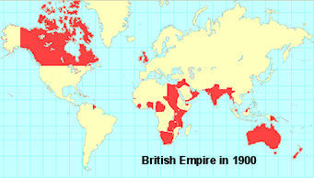
Britain was also nationalistic
Expressed mostly in imperialism – taking colonies in Africa and Asia
Queen Victoria led the way
R. 1837-1901

Slide 10
Russia always tried to match Western European countries
Peter the Great
R. 1721-1725
Tried to Westernize his country
Forced style changes
Forced some industrialization
Didn’t work
All czars after him tried similar things, and ended up only making the Russian people mad at all the new laws, taxes to support wars for colonization, etc.
The monarchy fell in 1917

Slide 12
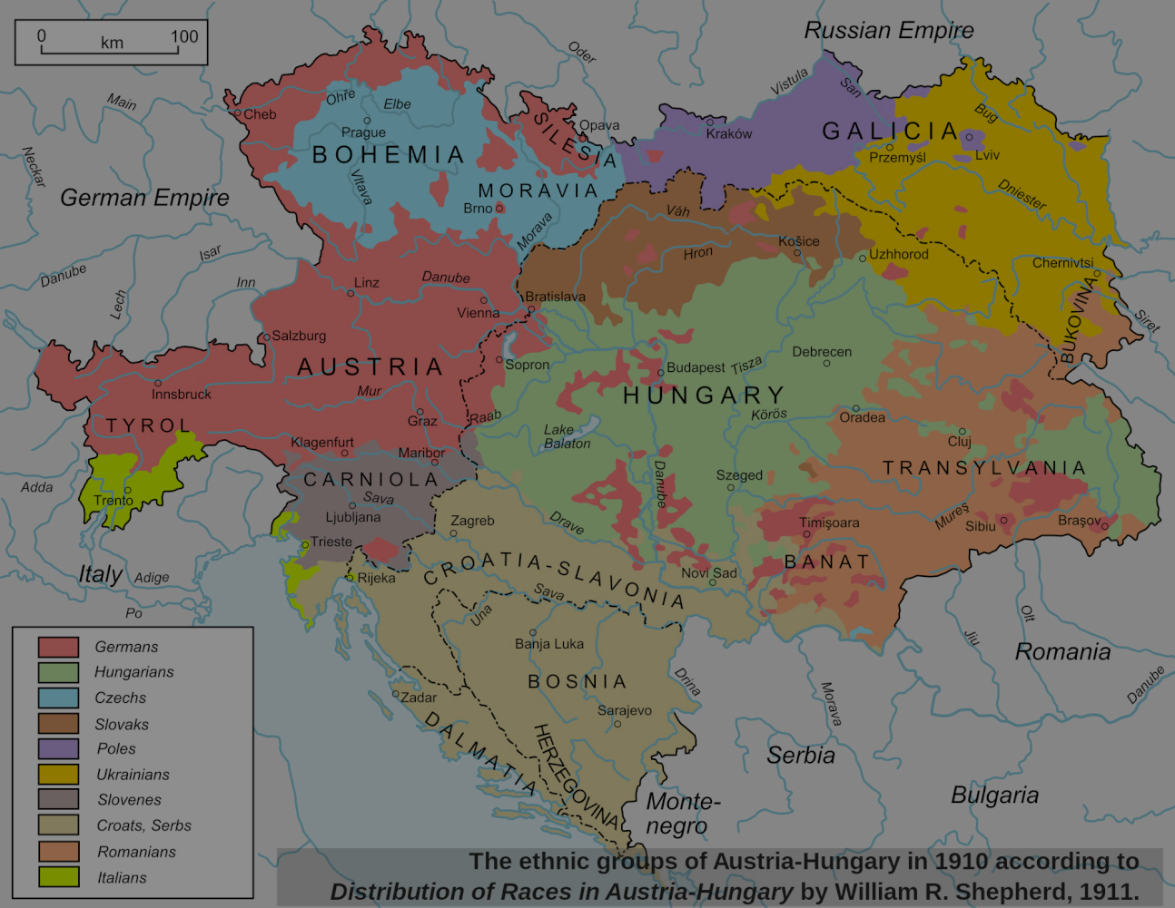
Austria-Hungary did not understand nationalism very well
Had been Holy Roman Empire 800-1300s
Then Austrian Empire, or Habsburg Empire, 1300s-1867
Then Austro-Hungarian Empire 1867-1918
Contained many different nations
Croats, Serbs, Bosnians, Italians, Germans, Hungarians, Russians, etc.
All of them wanted to rule, or at least not be ruled by Austrian Germans

Slide 13
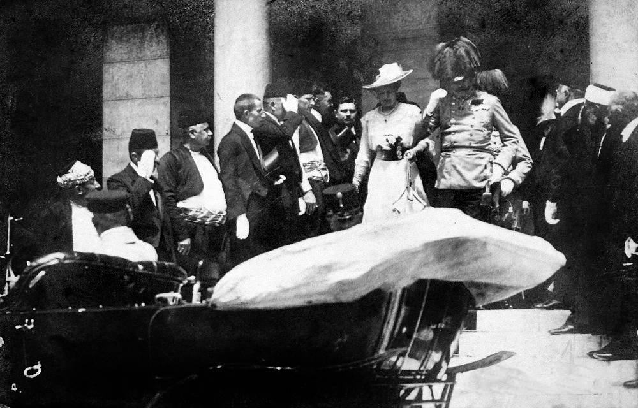
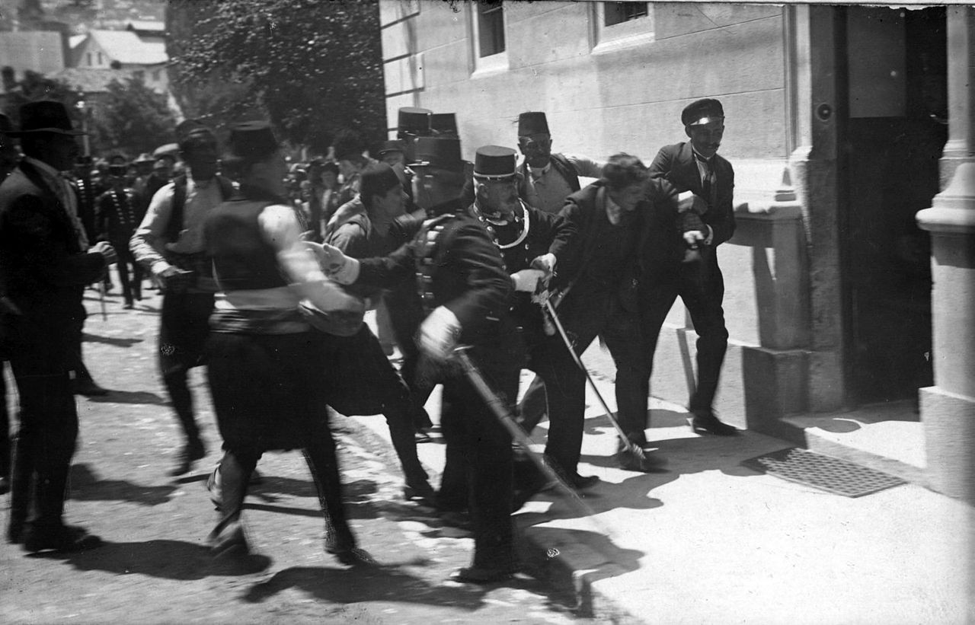
Austrian Emperor did not understand nationalist feeling, but was pressured enough by Hungarians to change some things in 1867
Hungary got its own parliament, which ruled eastern half of empire, Hungarian became official language for eastern half
But that made all the other nations in the Empire made
So on June 28, 1914, the Bosnians and Serbs had had enough
They shot the crown prince of Austria
A month later, the world was at war

Slide 14
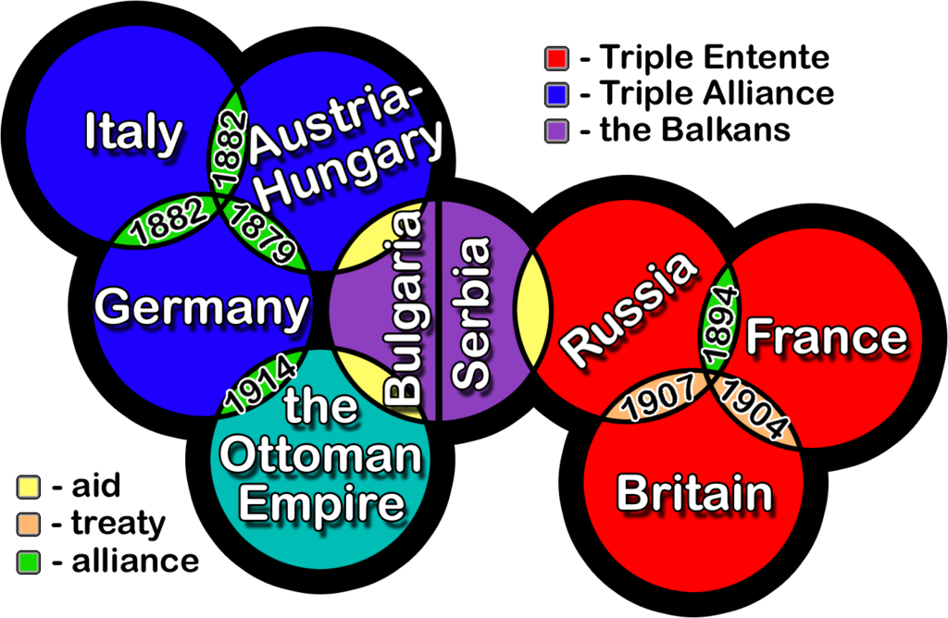
Why did one assassination send the world to war?
Because of treaties between nations
1815 Congress of Vienna sent Napoleon into final exile
And also worked to make sure another Napoleon could not happen
France was made to pay
Various countries made alliances with each other promising to go to war if anyone invaded the other

Slide 15
Bellwork 4/9/15
Prepare notes for our Socratic Seminar today. Make space in your notes for interesting thoughts about, and answers to, the below questions:
How did Bismarck unify the German nation into an empire?
How did Mazzini unite the Italian nation into a country?
Why did Germany need colonies? (Friedrich Fabri)
Why did Kipling think Europeans needed to take colonies?
How was Italian nationalism connected to conservatism and liberalism? (Raymond Grew)
How was German nationalism connected to conservatism and liberalism? (David Blackbourn)

Slide 16
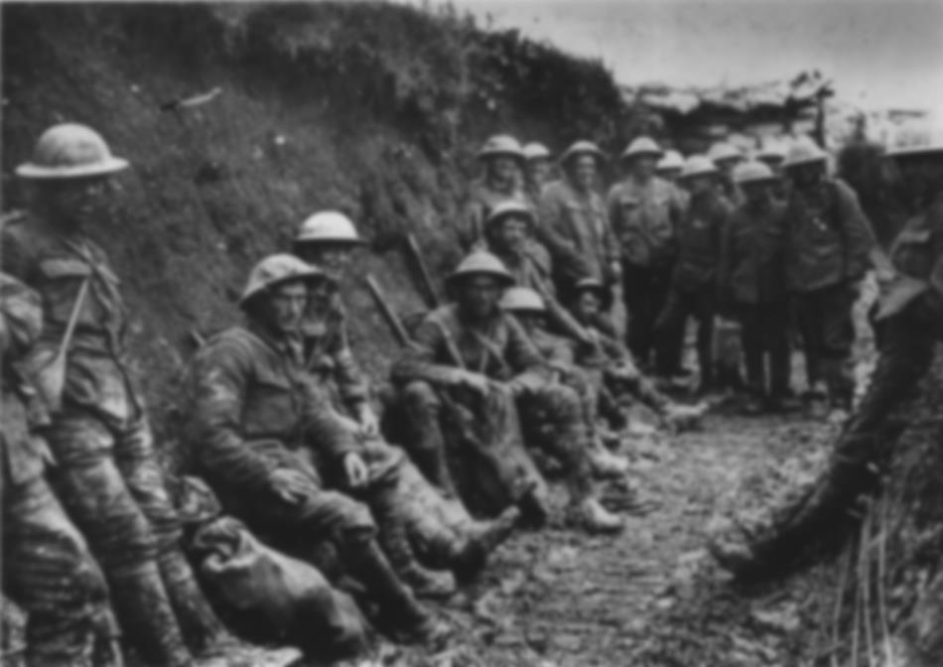
The First World War
June 28, 1914: assassination of Archduke Franz Ferdinand
August 4, 1914: the world was at war
Central Powers: Germany, Austria, Ottoman Empire
Allies: France, Great Britain, Russia
First industrialized war
Changed the way the West viewed war
Medieval – a game of skill played only by the elite
WWI – mass murder accomplished by anyone who can operate a simple machine
Strategies don’t work, settles down into trench warfare
Rats, trench foot, claustrophobia, fighting unseen enemies

Slide 17
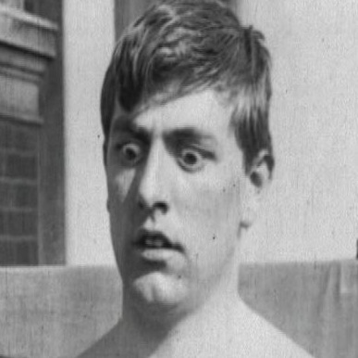
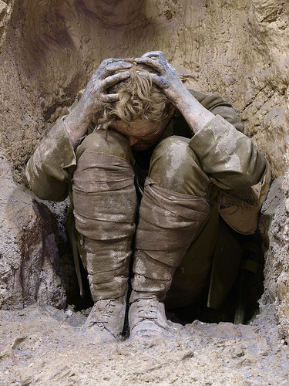
Impact of WWI
Excitement to go to war turned into horror
Shellshock
The Lost Generation
The Treaty of Versailles
Signed 1919
Blamed Germany for the war
Made Germany pay billions in reparations
Made Germans feel tricked, unjustly blamed, insignificant
Many say the treaty allowed Hitler to come to power in Germany and cause WWII

Slide 18
Bellwork 4/10/15
Prepare to finish yesterday’s Socratic Seminar on nationalism and imperialism.

