Slide 1
Bellwork 3/23/15
Using the first quote in italics from Edward Baines at the beginning of Lecture 17, answer the question below in at least five sentences (a full paragraph) –
Why did Britain industrialize before, and faster than, all other countries?

Slide 2
Quiz 3/23/15
The Industrial Revolution was revolutionary because it changed technology, but it also transformed English, European, and American ____________.
Who was the Scottish engineer who created an engine to pump water three times as quickly as the Newcomen engine?
What were the years of Charles Dickens’ lifetime?
Karl Marx disagreed with which German philosopher?

Slide 3
Grading the Quiz
Society
James Watt
1812-1870
Hegel

Slide 4
Three revolutions
American (1776-1783)
13 British colonies in North America declared and won their independence from the British Empire
Newly independent states united into a country that eventually became the most powerful country on earth
French (1789-1799)
French people overthrew and executed their king and established a republic
Republic gave in to empire, then republic again, then monarchy again, then republic again…
Industrial (1750s-1914ish)
First – machines, factories, steam power…
Second – chemicals, telephone, automobile, airplane…

Slide 5
American Revolution
Caused by Britain needing to get out of debt for French + Indian/Seven Years’ War
Parliament taxed the colonies for whom they had fought
Colonists would not pay because they had no vote in Parliament
Argued they had their own parliaments, and only king could tax them
Hurt Britain’s leadership in the world
World’s best navy and army defeated by inexperienced soldiers
Bankrupted Britain
Encouraged France in her hatred of Britain
Although sending military aid to American colonists hurt their economy
Encouraged Irish to rebel, as they continue to do today
Short-term bitterness between the new American country and Britain
Long-term friendship born between France and America
Influence would slowly move away from Britain towards America
Others encouraged in freedom-fighting against empires

Slide 6
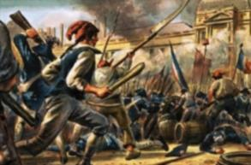
French Revolution
King Louis XVI and Queen Marie Antoinette ignored problems
Debt from Seven Years’ War and American Revolution
Wages low, food prices rising
Social classes frustrated at each other
First Estate: 10,000 clergy, owned 5-10% of French land, not taxed
Second Estate: 400,000 nobility, not taxed
Third Estate: 25 million others, especially peasants, farmers, workers were heavily taxed
Kings did not call Estates General often – 1789 was the first time since 1614
But 10,000 clergy had as much say as 25,000,000 people
All estates got frustrated with the king’s plans
Third Estate invited others to meet without the king

Slide 7
Bellwork 3/24/15
The third, fourth, and fifth paragraphs on page 6 of Lecture 17 talk about how optimistic Westerners became during the Industrial Revolutions. Answer the question below in at least five sentences (a full paragraph) –
Why did industrialization make Westerners optimistic? Should they have been? Has their hope for mankind been fulfilled?

Slide 8
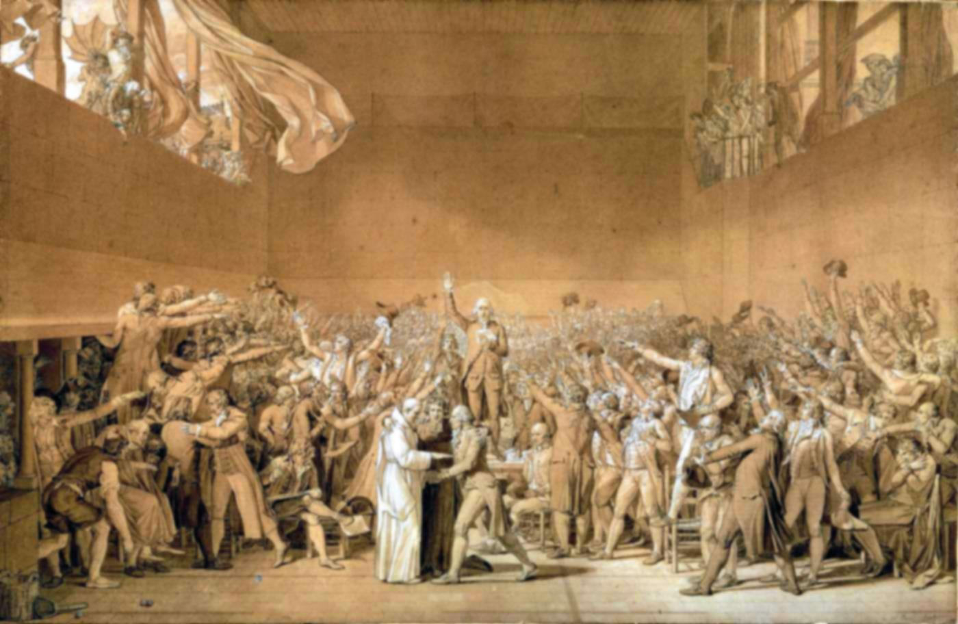
Tennis Court Oath
First and Second Estates too scared to meet without king’s permission
Third Estate met by itself, but Louis found out and locked them out of the Estates General building
They moved to an indoor tennis court
They vowed to each other not to quit meeting until they had written France a new constitution
Stormed the Bastille Prison to free some imprisoned by Louis for debt
Ended up killing a lot of other people as well
Wrote “The Declaration of Rights of Man and Citizen” in partial imitation of the American Declaration
Forced nobility to give up their rights
Louis XVI declared war on Austria and Prussia
To prove his dedication to the new direction of France
But he was guillotined in 1793

Slide 9
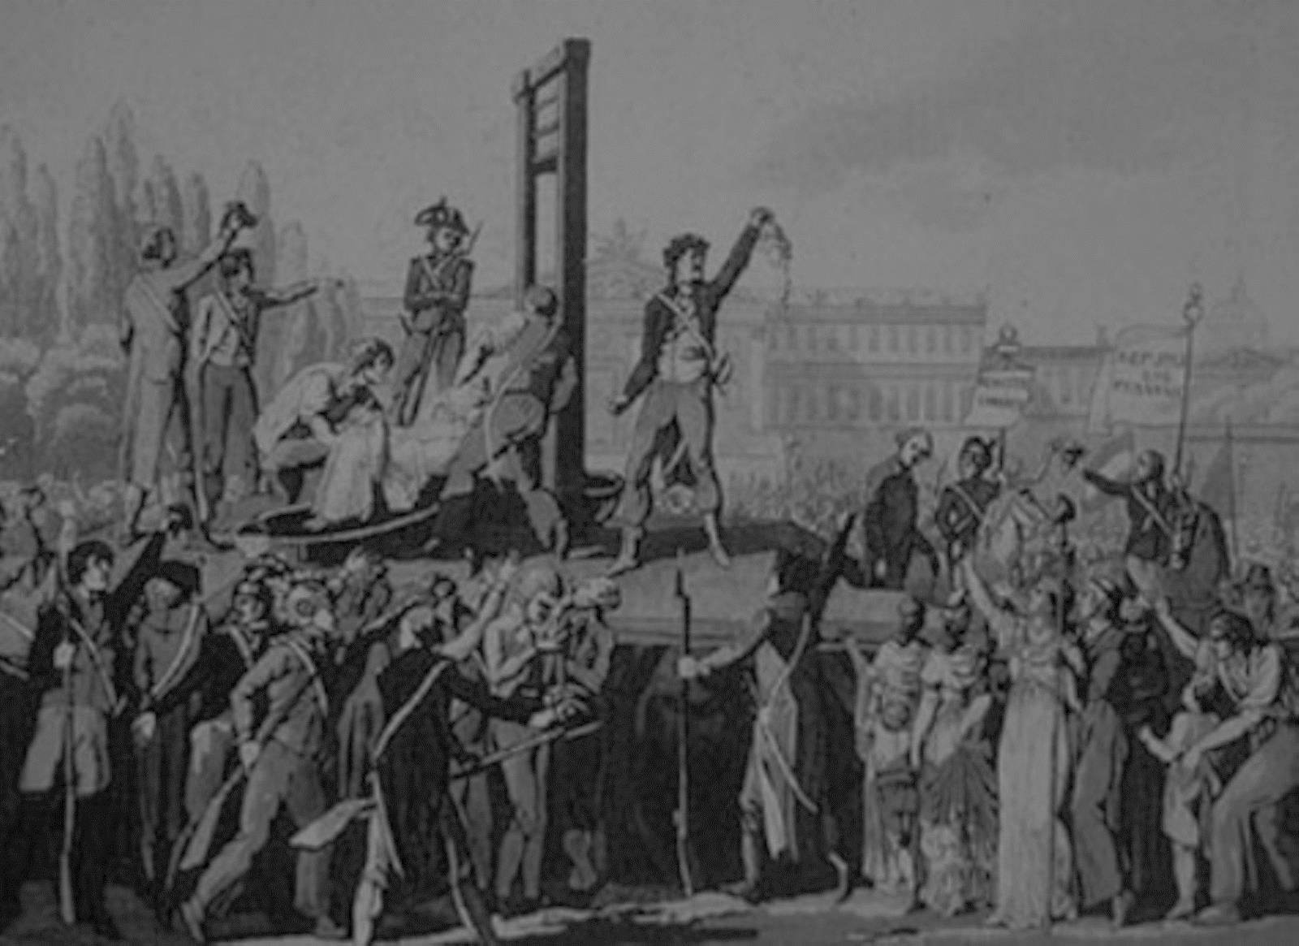
First Republic (1793-1795)
Continued wars against other European regions
Some defeats allowed Jacobins to come to power
Robespierre’s Reign of Terror began
16,000-40,000 civilians killed
Napoleon gained popularity by winning major battles
Thermidorian Reaction (1795-1799)
The Directory council ruled France
De-Christianized France
Changed the calendar
10 days in a week (renamed days; can’t have Greek, Roman, and Norse gods as day names)
3 decades (the new week) in a month
Renamed the months (can’t have Roman emperors as month names)
Made clergy employees of the state
Can thereby control them
Took over the Notre Dame Cathedral and renamed it “The Temple of Reason”

Slide 10
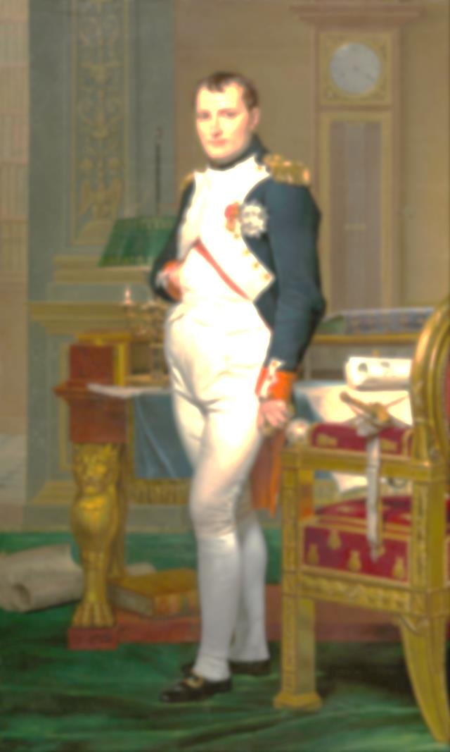
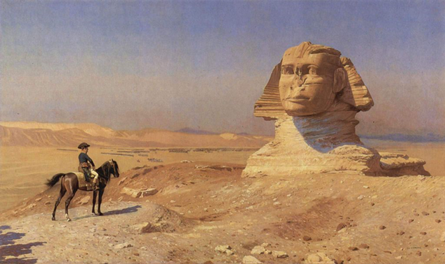
Napoleon
Born on Corsica in 1769
Three years after it had been taken from the Italians by the French
Son of old, but poor, lower nobility
Excellent, but arrogant, military student
Artillery officer
Fought in, and survived, the French Revolution
1798: Thermidorian government sent him on an expedition to Egypt to get him out of the country because they knew his reputation was growing
But he used it to send home propaganda-like paintings and essays about his great work and heroism
He only became more loved by the French people

Slide 11
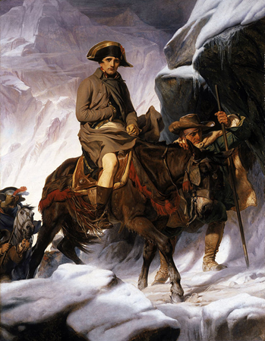

Slide 12
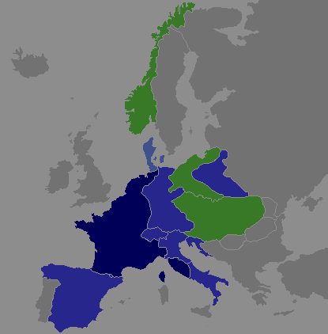
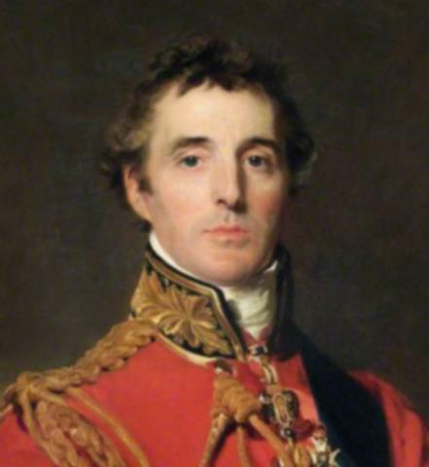
Declared himself First Consul in 1799
Notice the Roman Republic reference
Began invading other countries
Crowned himself Emperor of France in 1804
Defeated or made alliances with Spain, Germany, Austria, Poland, parts of Russia, etc.
Europe terrified of becoming a French empire
Britain led many coalitions against him
Sixth coalition was finally successful in 1814
Leaders of European countries exiled Napoleon to an island named Elba
Escaped from exile in 1815
Declared himself emperor again, many French supported him
Launched more invasions
Duke of Wellington defeated Napoleon at Waterloo
Congress of Vienna exiled Napoleon again, this time to an island named St. Helena
Died there in 1821

Slide 13
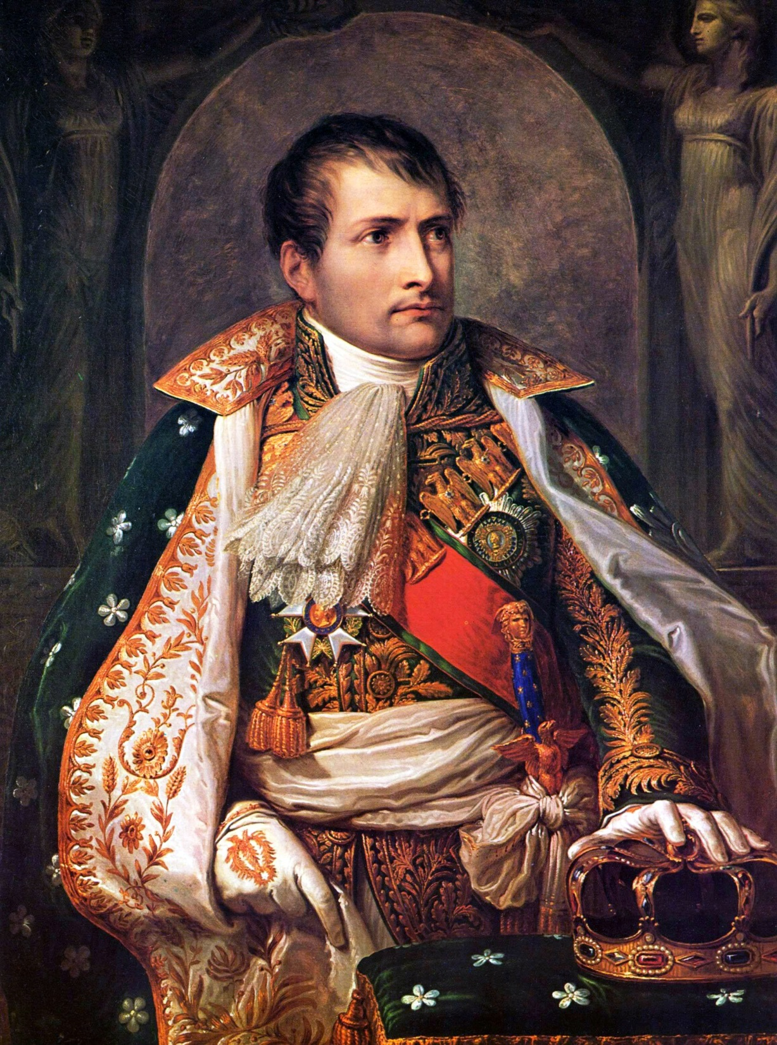
Napoleon
First modern dictator?
Preserver of the Revolution?
Son of the Enlightenment?
Fake?
Imposed a “Civil Code” on France and all of his conquered territory
Fake re-religious-izing after the Enlightenment
Anti-women’s rights

Slide 14
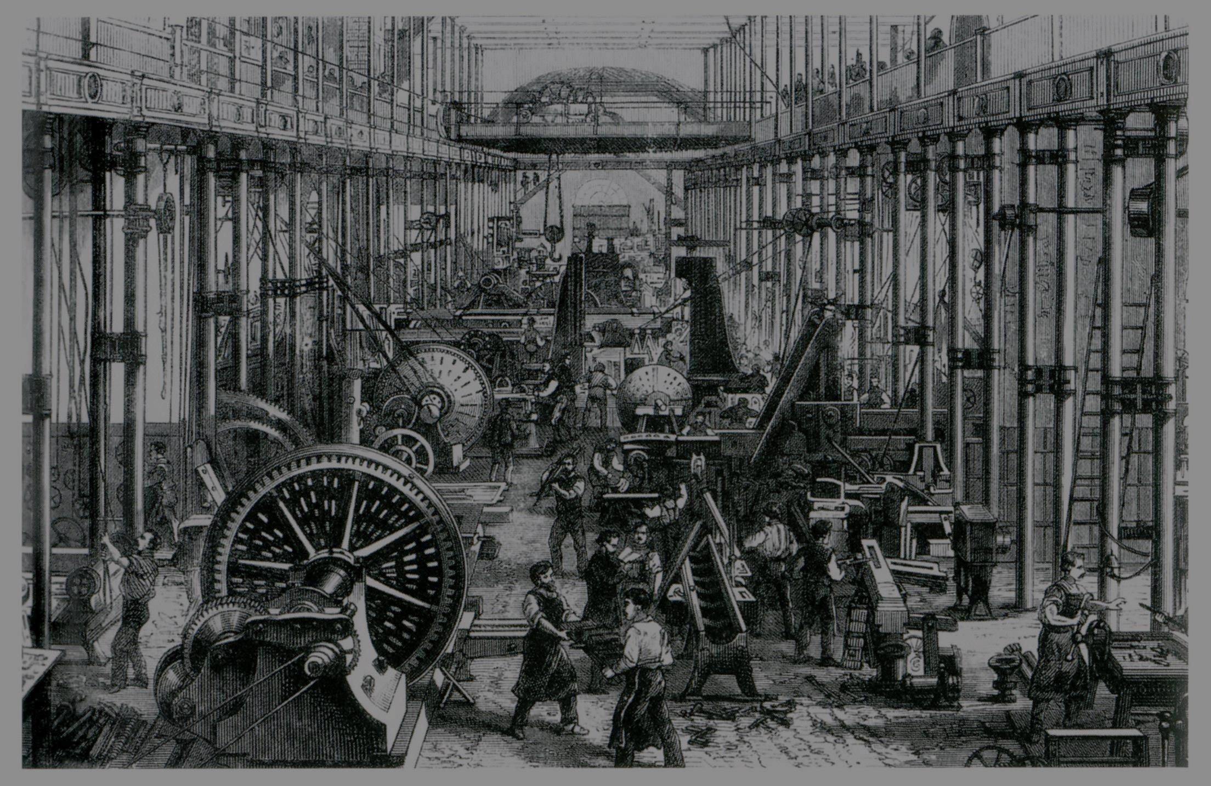
First Industrial Revolution (1750s-1850s)
England led, became “Workshop of the World” until late 1800s
Because they had low taxes, political freedom
Invented labor-saving devices (machines)
Plows
Steam Engine
Yarn-spinning
Developed factories (mass-production) as the new way to produce everything
Clothing
Food
Westerners became very optimistic, hopeful about the future, given what technological wonders humans could produce

Slide 15
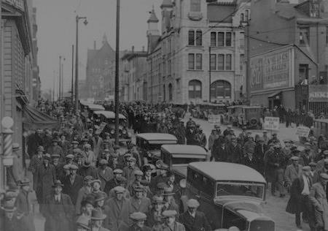
Second Industrial Revolution (1850s-1914ish)
First in Germany and United States
Bessemer steel-making process
Factories run on electricity instead of coal/steam
Massive increase in railroads
Use of oil
Petroleum
Plastics
Internal combustion engine
Chemicals
Electronic communications
Telegraph
Telephone
Radio

Slide 16
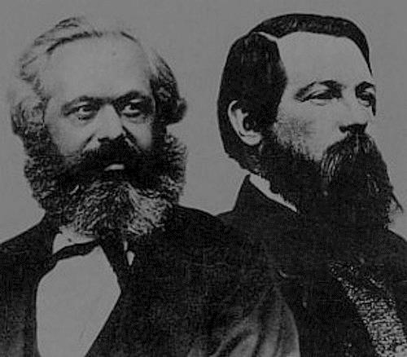
19th-Century Ideologies / The Romantic Era
Responses to industrialization
Liberalism
Continuation of Enlightenment
Want democracy, no kings, no aristocracy
Conservatism
Reaction against Enlightenment
Want kings, aristocracy, church, tradition, slow change
Marxism/Communism
Karl Marx (German, 1818-1883)
Communism = workers will eventually rule the owners, will share everything, no ownership, but usually requires some force (so you do need a ruling class)
History = a struggle between rich and poor that will eventually end with those at the bottom not being ruled anymore

Slide 17
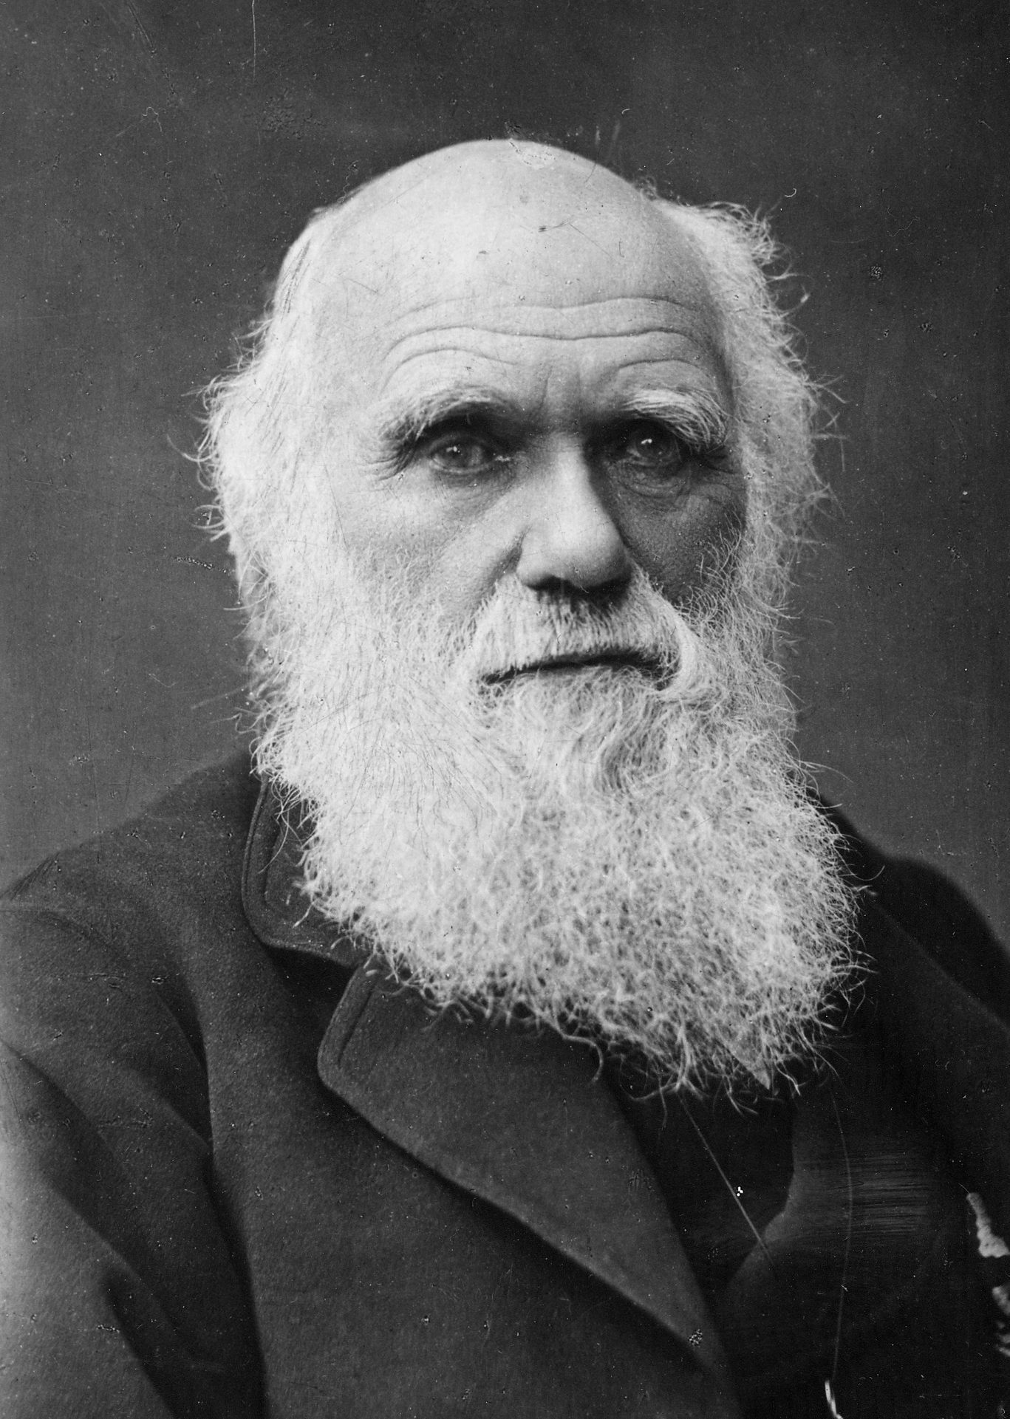
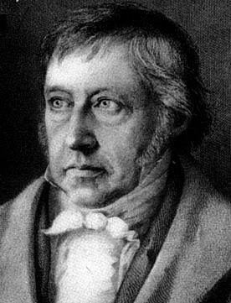
Darwinism
Charles Darwin (English, 1809-1882)
Macro-evolution of species
Many took Darwin’s ideas much further than he meant
Social Darwinism – social classes and countries evolve through the survival of the fittest, Blacks and Jews are at the bottom
Biological Evolution – humans come from goo, which became fish, which became apes, which became humans
Hegelianism
Georg Wilhelm Friedrich Hegel (German, 1770-1831)
History is made by great men who can be considered supermen, they are allowed to commit crimes if need be
Some considered Napoleon to be a superman
Beethoven did for a while

Slide 18
Luddism
Violent destruction of machines
Because machines put them out of jobs, and seemed inhuman
1811-1817
Socialism
Robert Owen (British, 1771-1858)
Everything owned in common, not as radical as communism
Anarchism
No government or laws
Romanticism
Mix of Enlightenment and Middle Ages
Passion, risk, adventure, heart, love, drama, irrationality is ok

Slide 19
Socratic Seminar
Read and annotate
Workers’ Petition
How do some workers in the First Industrial Revolution see industrialization?
Why do some workers see industrialization as a bad thing?
Letter from Merchants
How do some merchants in the First Industrial Revolution see industrialization?
Why do some merchants see industrialization as a good thing?

Slide 20
Presentations 3/27/15

