Slide 1
Bellwork 4/16/15
Using the handout titled “Turmoil Between the Wars,” answer the question below in at least five sentences:
Describe the changes in government that happened in Russia, Italy, and Germany as a result of the First World War.

Slide 2
Quiz 4/16/15
What was the name (starting with a B) of Russia’s Revolution of 1917?
Adolf Hitler captured Germany with the hope of creating a thousand-year ______ ______
The Second World War was ________’s war.
When did American forces drop a nuclear bomb over Hiroshima? (Month, Day, Year)

Slide 3
Grading the Quiz
Bolshevik
Third Reich
Hitler’s
August 6, 1945

Slide 4
Interwar years
1919-1939
Russians became communist
Treaty of Versailles frustrated Germans
Great Depression hurt American and European economies
First industrialized war changed society
Women’s roles
Class barriers
Opinions on war

Slide 5
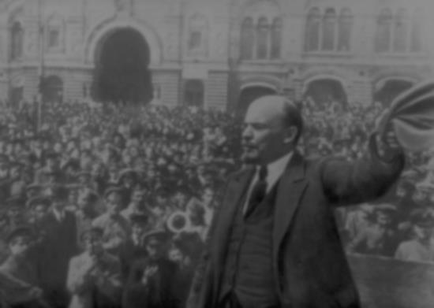
Russian Revolution
February 1917: people overthrow 1500-year-old czarist government
Provisional Government set up
Bolshevik (minority) Party led by Communist Vladmir Lenin leads revolts against Provisional Government
October 1917: Bolsheviks overthrow Provisional Government
Communist until 1990
Government owns all land, factories, transportation, etc.
Employs all Russians
Feeds all Russians
Therefore, can control all Russians
Secret police spied on Russians, spies spied on West

Slide 6
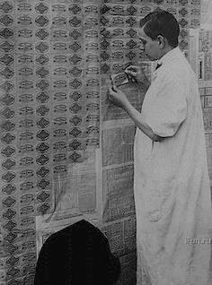
Weimar Republic
Name of German government after Kaiser abdicated in 1918
German people not educated/prepared for republican government after centuries of monarchies
Treaty of Versailles required Germany to pay allies billions in reparations
HUGE economic problems
Wheelbarrows of money to buy a loaf of bread
Cheaper to burn money as fuel or use it as wallpaper than to buy things with it
Felt tricked by the allies, unjustly blamed, looked down upon, “stabbed in the back”

Slide 7
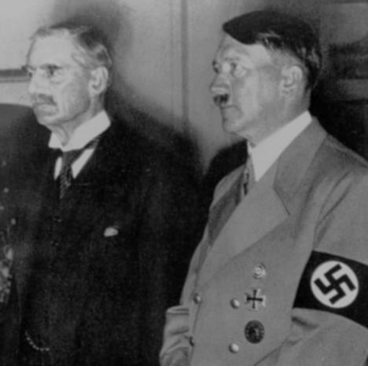
Appeasement
Britain terrified of war again, France still terrified of Germany
Once Hitler came to power in 1933, Germany began disobeying the Versailles Treaty
Rebuilt army, navy, air force
France saw and tried to alert the world to it
Britain didn’t want to pressure Germany because it feared war again
Neville Chamberlain, British Prime Minister, 1937-1940
Met with Hitler several times
Let Hitler take various zones he wasn’t supposed to have
Said he agreed with Hitler that Germans only needed Lebensraum because of how they’d been restricted by Versailles

Slide 8
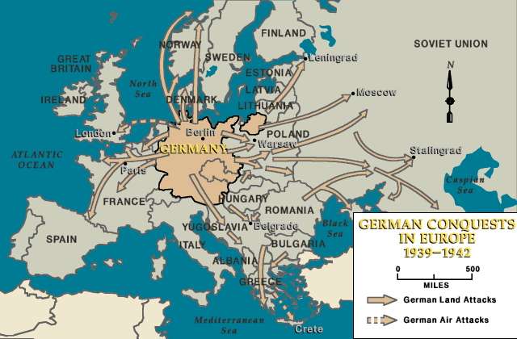
WWII
1939-1945
Started when Hitler invaded Czechoslovakia
Had already invaded Sudetenland and Austria in 1938
Chamberlain had done nothing, although Winston Churchill had warned him of Hitler’s aims, laid out in Hitler’s book Mein Kampf, written in jail in the 1920s
Britain and France declared war
Feared yet another Napoleon situation
Only some knew about the anti-Semitism

Slide 9
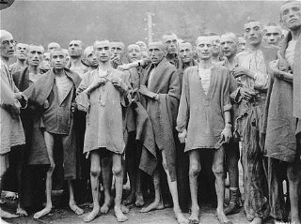
Holocaust
Not that weird for that time
People groups in the Austrian and Ottoman Empires had been slaughtering each other for centuries
Even Americans in 1920s thought of various people groups as less evolved and not worthy to have kids
But intensity and scale of Hitler’s program made such treatment of minority groups unpopular
6 million Jews, and 1 million others, killed within 6yrs
Many others starved, made insane, etc.

Slide 10
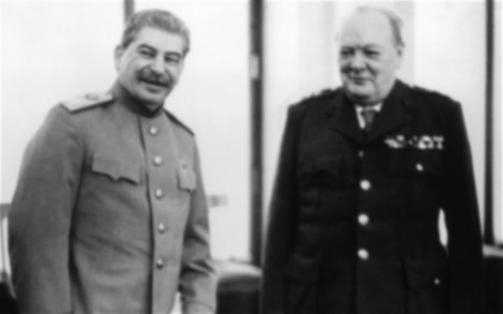
Winston Churchill
British Prime Minister, 1940-45 / 1951-55
Knew his enemy, would not give up, inspiring
Helped lead Allies to victory in WWII
Joseph Stalin
General Secretary of Communist Party, 1924-53
Responsible for at least 60 million deaths worldwide because of the spread of communism
Was on Allied side during WWII, then our enemy until 1990

Slide 11
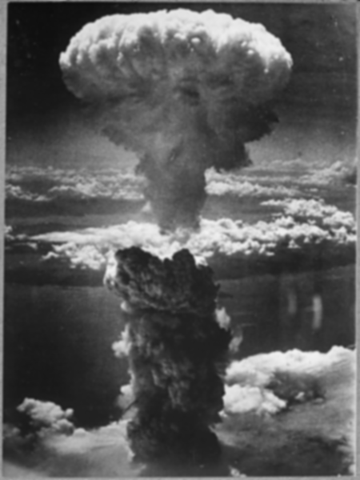
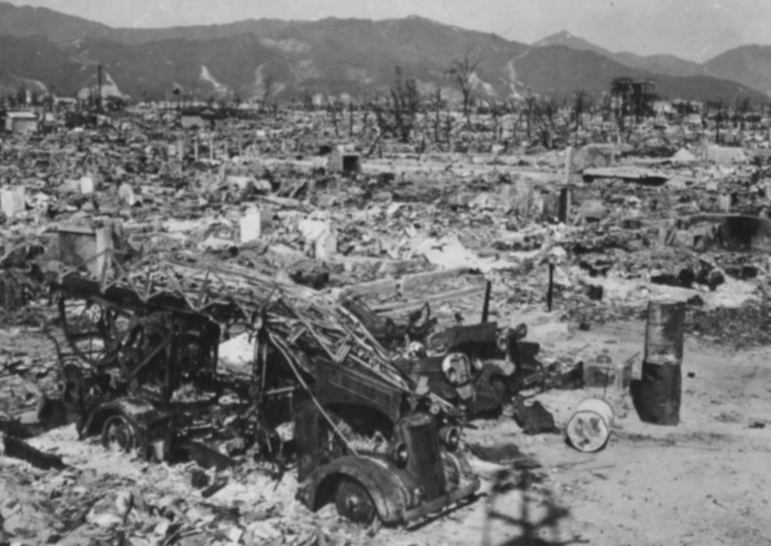
German surrender
May 7, 1945
Nuremburg Trials
13 trials between 1945 and 1949
Major war criminals, doctors, etc. involved in Holocaust
Japanese surrender
After two nuclear bombs (Hiroshima/Nagasaki)
Would not have given up fighting the U.S., thought surrender less honorable than death
75,000 people died
September 2, 1945

