Slide 1
Bellwork 4/27/15
Using page 773 in Barzun, answer the question below in at least five sentences:
What does the word demotic mean, and why does Barzun think the 20th century can be described as a demotic time?

Slide 2
The Cold War
Technical definition: a hot war has come to an end, but not all of the combatant countries have signed treaties with each other, resulting in a stand-off between some of the former combatant countries
1945-1990
U.S. and U.S.S.R. compete for influence in Europe
Started with the negotiations over how to occupy WWII-torn Europe
Obvious Russia was not going to rebuild and back out
So America had to stay as well
Featured an arms race, a space race, and at least two hot wars

Slide 5
Flashpoint: Berlin
Where most of the diplomatic, espionage, and military hot periods of the Cold War broke out
Where both sides could look each other in the face
Where both sides’ wish to influence Europe came into direct conflict
City was split into four occupied zones, just like Germany was, but the city was located in the Soviet zone (East Germany)
The Soviet zone of the city (East Berlin) became increasingly poor, ruled by totalitarian communists
Many people tried to get into the West part of the city to get flights out to Western Europe or America
Eventually, the U.S.S.R. had to put up a wall around West Berlin to keep people from getting out of East

Slide 6
Arms Race
U.S. obviously already had nuclear arms, because we had used them in August 1945 against Japan
U.S.S.R. needed to match U.S. to make sure it had influence in the world that matched the U.S.’s
Both sides assumed about each other, and spied on each other, and raced to the largest number, and most powerful, nuclear arms
MAD = Mutual Assured Destruction
The policy both sides worked under
If you use a nuclear weapon, I will too, which means we will completely decimate each other’s populations and infrastructure…. So let’s not really ever use them…. But let’s threaten each other with the possibility of using them….

Slide 8
Bellwork 4/28/15
The West’s space race with the U.S.S.R. caused Western education to value math and science over the other liberal arts. Answer the question below in at least five sentences:
Was it necessary to change Western education during the Cold War? If so, why, and should we change back (how?)? If not, why not, and can we change back (how?)?

Slide 9
Space Race
Space exploration was the next new technology, and both sides had to show the world that they were the first and best at it
1957 U.S.S.R. beat U.S. to launching a satellite
Sputnik (means “fellow traveler of earth”)
Both sides made sure their education systems focused on math and science to produce the world’s best scientists to beat the other side
U.S. education system quit valuing the liberal arts altogether – no more Latin, history, literature, music, art, etc.

Slide 10
North Atlantic Treaty Organization vs. Warsaw Pact
NATO: military alliance between Britain, America, and other Western European nations defending each other against Soviet invasions, and trying to pull others under their influence
Warsaw Pact: marketed as a protective and economically-helpful treaty with U.S.S.R., but then inevitably turned into each country that signed on becoming a territory of Russia, required to have a totalitarian communist government

Slide 12
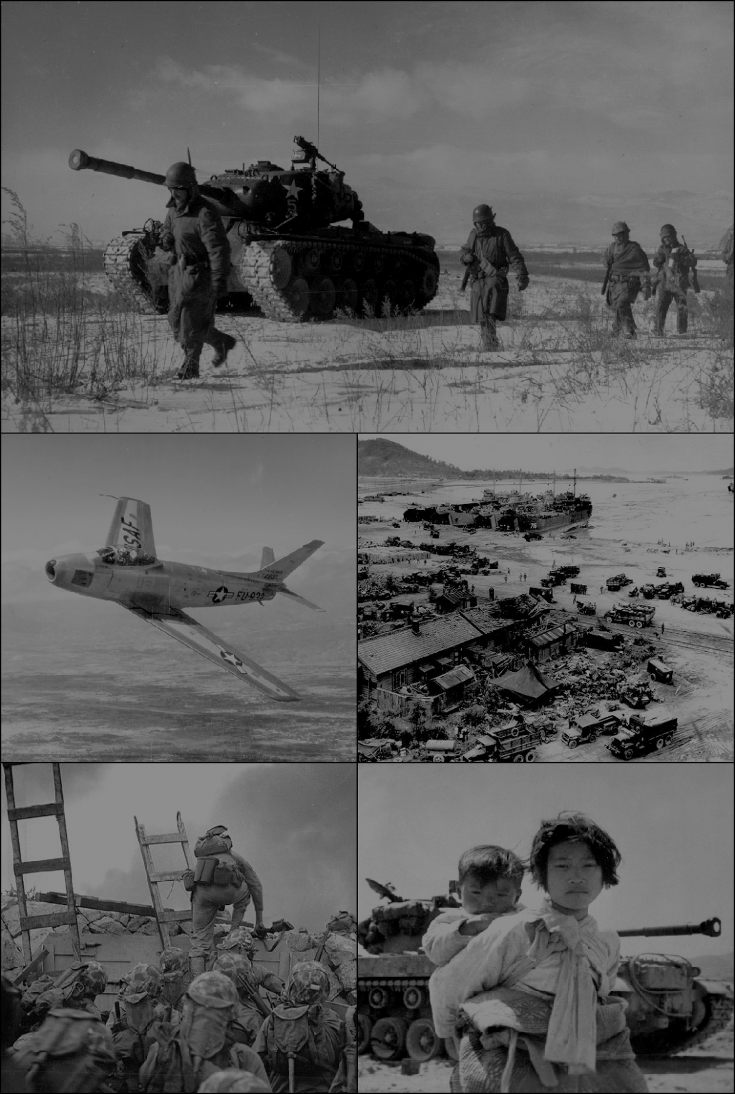
Korean War
1950-1953
North Korea vs. South Korea
North supported by China and U.S.S.R., South by U.S.
Split by allies after it was taken from Japan in 1945
Both regions claimed to have the legitimate government for the whole peninsula
Neither government would respect the border between the allied occupation zones at the 38th parallel
North Korea invaded south of the 38th parallel in June 1950
Mostly stalemate at the 38th parallel
Jet aircraft used in air-to-air combat for the first time
Armistice signed June 1953 creating demilitarized zone

Slide 13
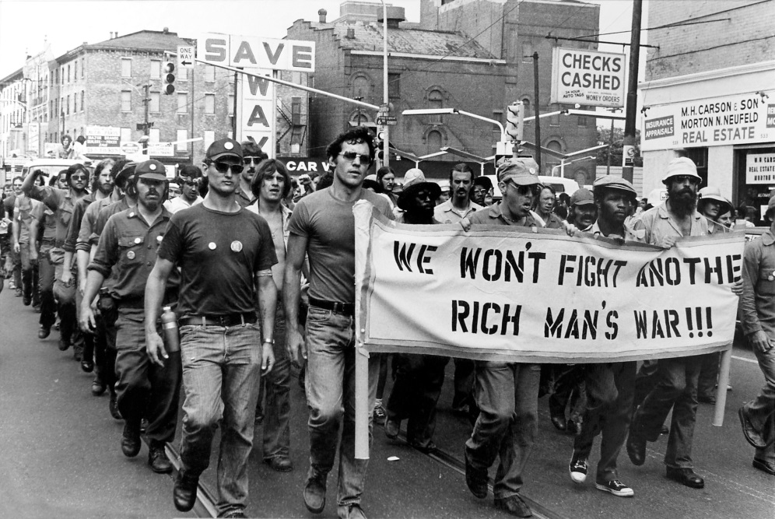
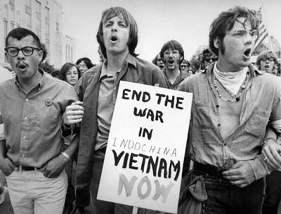
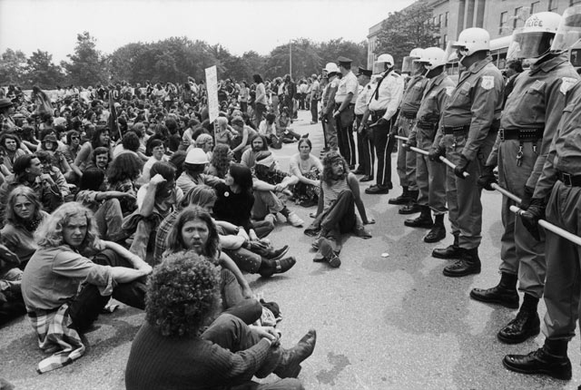
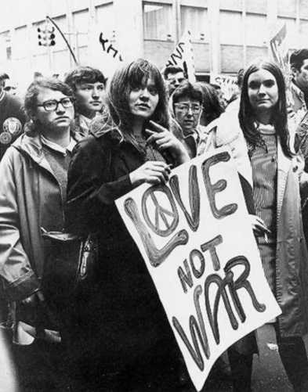
Vietnam War
1955-1975
North Vietnam vs. South Vietnam
North supported by China and U.S.S.R., South by U.S.
Large-scale strategic bombing
1960s counterculture protested U.S. involvement in containing Communism
After scale-down, involvement officially ended 1973
1975 armistice re-united Vietnam under the brutal, communist group Viet Cong/People’s Army of Vietnam

Slide 14
Socratic Seminar 4/29/15
Read and take notes on Aspects of Western Civ:
374: The Marshall Plan
383: The Soviet Victory
384: The Iron Curtain speech
385: The Truman Doctrine
393: The Secret Speech
394: The Brezhnev Doctrine
398: Tear Down This Wall
400: Perestroika and the Socialist Renewal of Society
Draw a timeline in your notes, putting these documents and their ideas in chronological order

Slide 15
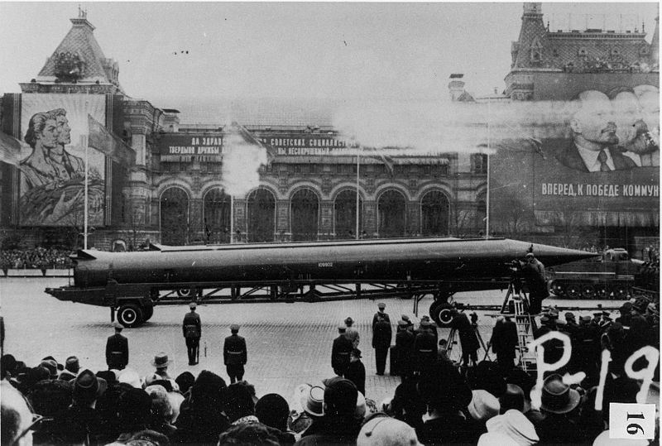
Cuban Missile Crisis
October 14-28, 1962
Closest Cold War came to full-scale nuclear war
U.S. attempted invasion of Cuba at Bay of Pigs in 1961
U.S. stationed missiles in Italy and Turkey in range of Moscow
Soviet leader Nikita Khrushchev and Cuban leader Fidel Castro met to discuss how to deter U.S. from influencing Cuba
U-2 spy planes photographed missiles on newly-constructed launch pad, 90mi from Florida
U.S. established military blockade to keep more missiles out
Tense few days, until JFK and Krushchev agreed – U.S.S.R. would take missiles back, U.S. would not invade Cuba

Slide 16
Berlin Wall
August 1961-November 1989
Officially referred to by Eastern authorities as the “Anti-Fascist Protection Rampart”
There was also the Inner German Border separating east and west
Came to symbolize the Iron Curtain
Before it was erected, 3.5 million circumvented border checkpoints
After it was erected, 5,000 attempted to escape, about 150 died doing so
Revolts all over Soviet bloc in 1989 pressured E Germany to announce that people could visit W
Crowds of euphoric people started hammering away at the wall and climbing over
Official reunification of Germany on October 3, 1990

Slide 21
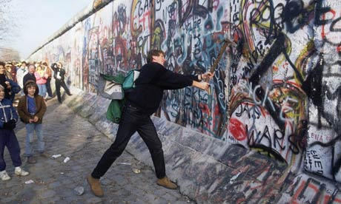

Slide 22
Phases of Cold War
Rollback (attempt to change Soviet government) 1945-1951
Harry Truman vs. Joseph Stalin
Containment (prevent Communist expansion) 1951-1969
Truman vs. Stalin, then Malenkov, then Nikita Krushchev, then Leonid Brezhnev
Dwight Eisenhower didn’t intervene in the 1956 Hungarian Revolt
Lyndon Johnson cited containment as reason for Vietnam
Détente (working relationship, relax tension) 1969-1979
Richard Nixon vs. Brezhnev
Jimmy Carter vs. Brezhnev
Containment 1979-1981
Carter vs. Brezhnev, then Yuri Andropov
Rollback 1981-1991
Ronald Reagan vs. Andropov, then Chernenko, then Mikhail Gorbachev
Revolts in Soviet bloc countries
Fall of USSR

Slide 23
Bellwork 4/31/15
Prepare your notes for today by titling and dating them, and writing these questions with space in between for notes:
How did the Soviet Union win WWII, according to Stalin?
How does it seem Stalin was going to use his opinion about the victory in WWII to rule his empire?
How did Churchill describe the Iron Curtain and what was happening behind it?
How did Truman want to respond to the end of WWII?
What was the Marshall Plan?
How did Krushchev respond to the Cuban Missile Crisis?
What was the Brezhnev Doctrine?
How did Reagan fight the Cold War?
How did Gorbachev want to change Soviet society?

