Slide 1
Bellwork 5/4/15
Using the two paragraphs on postmodernism, answer the question below in at least five sentences:
What do postmodernists believe?

Slide 2
Quiz 5/4/15
Postmodernists react to assumed _________.
Postmodernists are skeptical of explanations that claim to be valid for _____ _______.
Postmodernism is “post” because it denies the existence of any _________ principles.
Even postmodernism’s own principles are not beyond ___________.

Slide 3
Grading the Quiz
Certainty
All Groups
Ultimate
Questioning

Slide 4
Review of eras
Ancient era
4000BC – AD400
Mesopotamia, Greece, Rome
Medieval era
AD400-1400
Christian Western Europe
Early Modern era
1400-1800
Renaissance, Enlightenment
Modern era
1804-1960
Napoleon, World Wars
Postmodern era
1960-today
Hippie counterculture, growth of atheism

Slide 5
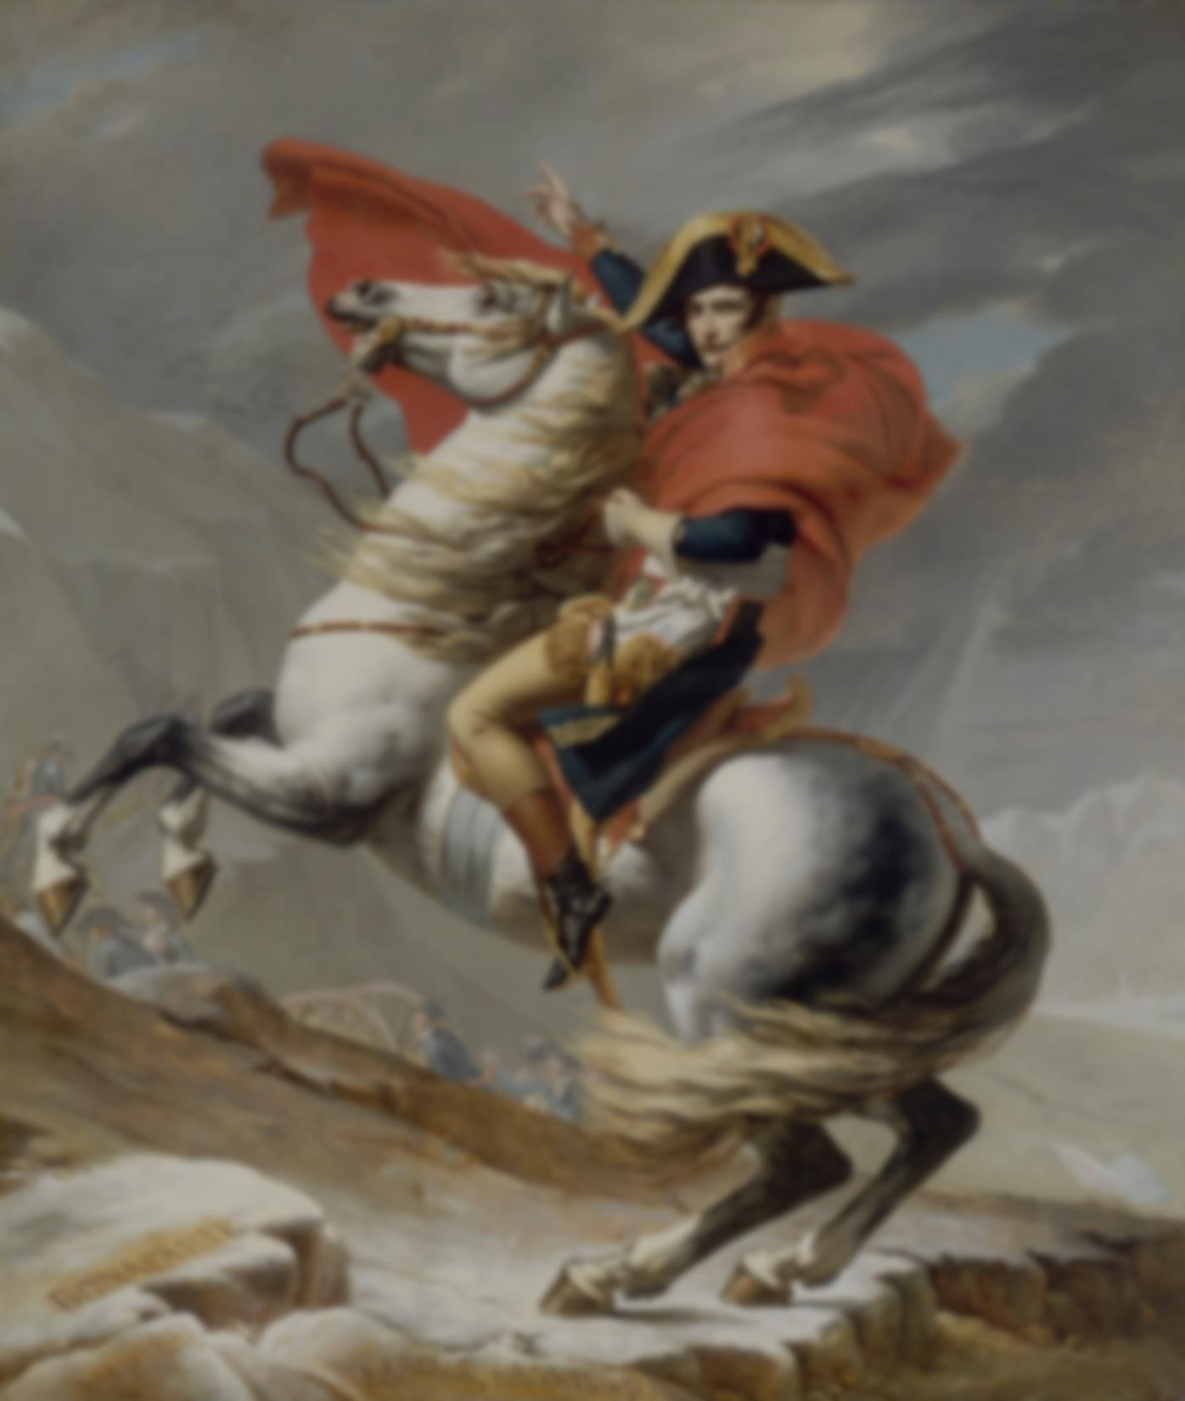
Modernism
1804: Napoleon crowned himself
Authority came from talent, merit, work, rather than from God, birth, blood
Governments used secret police and propaganda

Slide 6
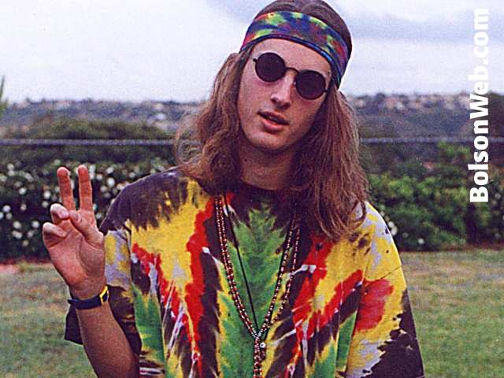
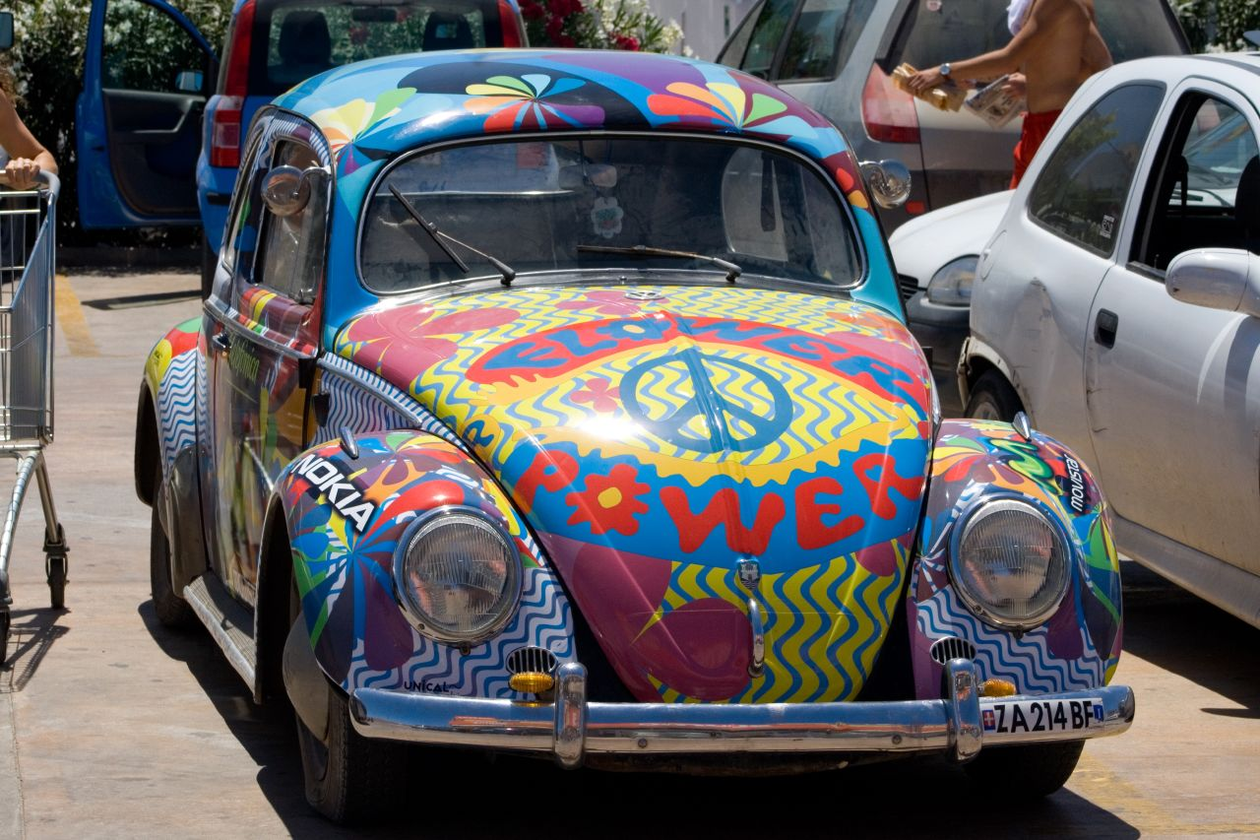
Postmodernism
1960: Hippies frustrated with boredom
Want to protest everything
Frustrated with all authority – church, parents, government, history, teachers, etc.
Infiltrate universities, become professors, writers, etc. who say there is no truth, you can say what you want, everyone can be right at the same time, etc.

Slide 7
Bellwork 5/5/15
Answer the question below in at least five sentences:
In 1922, Albert Einstein introduced his theory of relativity, part of which posited that measurements of various quantities are relative to the speed of the observer. How might Einstein’s discovery of relativity later have contributed to postmodernism?

Slide 8
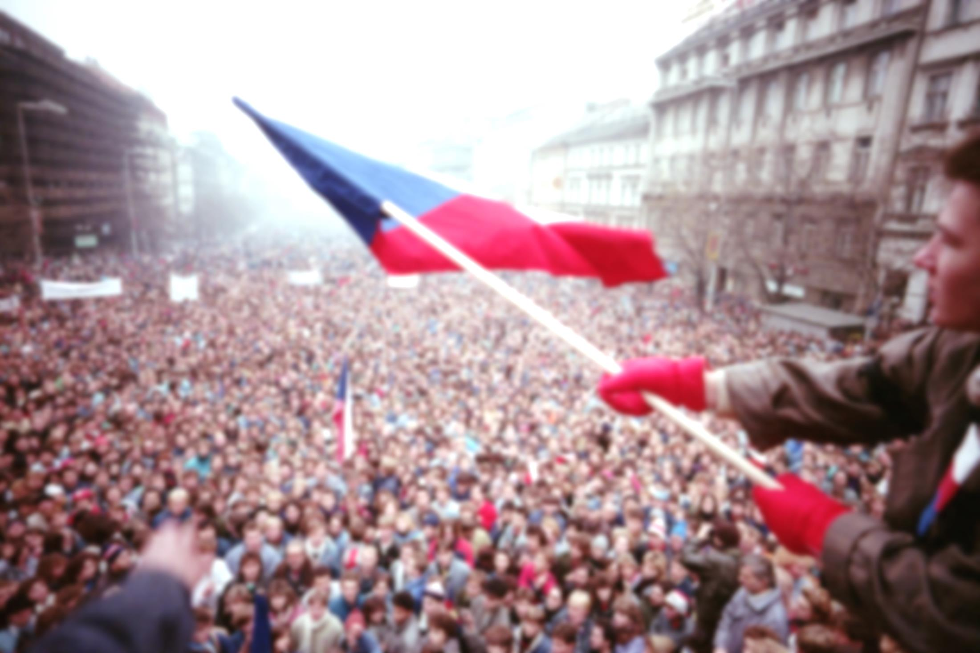
Post-Cold War Recovery and Integration
Germany
October 3, 1990 – East Germany and Berlin reunited to West Germany and Berlin
Now one of the most stable and powerful European countries
Eastern Europe
1989-1991 declared independence from USSR one by one
Western Europe helped them develop democratic governments and free economies, and get re-connected to Europe (USSR had banned trade between Warsaw Pact countries and the rest of Europe)
Today, some still have slightly communist governments

Slide 9
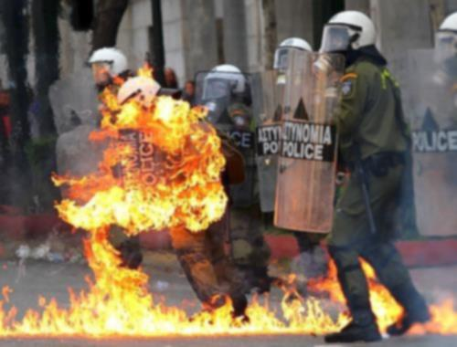
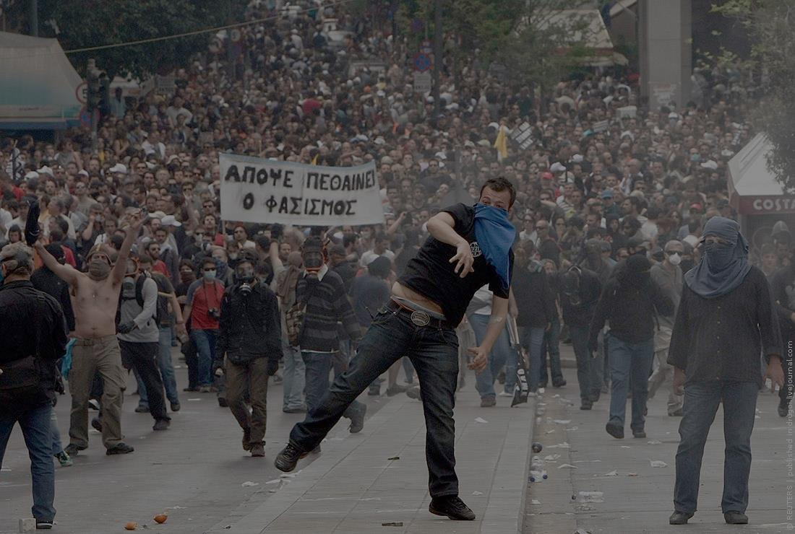
Post-Cold War Recovery and Integration
European Union (EU)
Transnational organization
Shared currency (the Euro)
Free trade agreements between member countries, restrictions on trade with non-member countries
National sovereignty often overridden
Has not been able to deal well with recent economic problems and some member countries (Greece especially) have descended into relative chaos

Slide 10
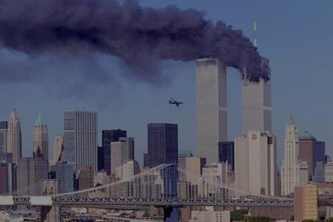
Hegemony
One country’s leadership of the world
Debatable, but the U.S. has it now
September 11, 2001
Westerners thought hijacking was just something the Soviets and some Muslim terrorists would do to gain ransom money, rarely to kill people
19 hijackers
Flight training in the U.S. for four years
Before that, trained in mindset, etc. in Iraq, Afghanistan
Careful planning
Second time U.S. experience attack on her soil
Fueled by religious hatred and jealousy/disapproval of the current hegemon

Slide 11
War on Terror / Current problems
2003 – U.S. and Europe allied against Muslim terrorists in the Middle East
European allies have slowly dropped out
U.S. has been pulling out
Hard for postmodern culture to fight a war against combatants of one religion
ISIS – Islamic State in Iraq and Syria
Violent religious fervor
Muslims are split on whether to support or condemn ISIS
China could become next hegemon
Quick, easy travel makes international health a concern

Slide 12
Socratic Seminar 5/7/15
Read and annotate:
Helmut Kohl’s A United Germany in a United Europe
How was a reunited Germany planning to contribute to Europe in the 1990s?
Vaclav Havel’s Czechoslovakia is Returning to Europe
How did former Soviet bloc countries feel about the end of the Cold War?
Vladimir Putin’s Communism: Far Away from the Main Stream of Civilization
How did Putin claim to feel about communism in 1999?
George W. Bush’s We Wage a War to Save Civilization Itself
How did the Western world feel about Muslim terrorism in 2001?

